Slide 1
Key Calendar Events
5 Dec-19 Subject Review Evening
3 Apr-20 Subject Review Day
28 Nov-19 Report 1
26 Mar-20 Report 2
21 Jul-20 End of year report
Monday 13th July to Friday 17th July 2020 = Y10 Work Experience
Summer Term 2020 Sixth Form Information

Slide 2
Mr P German
Headteacher

Slide 3
attendance@yateley
Average Attendance 2018-19
Year 7 – 11 = 94.7 %
Year 9 = 95.2%

Slide 4
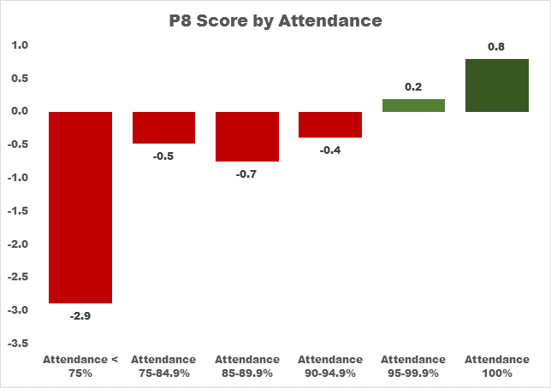
Gcse Results by Attendance
Students below 75% attendance averaged almost 3 grades below their targets
Students with 100% attendance averaged almost a grade above their targets

Slide 5
Homework – Independent Study
Preparation
Consolidation
Learning
Between 2 and 3 hours per night
Weekends between 4 and 6 hours
Revise and review regularly

Slide 6
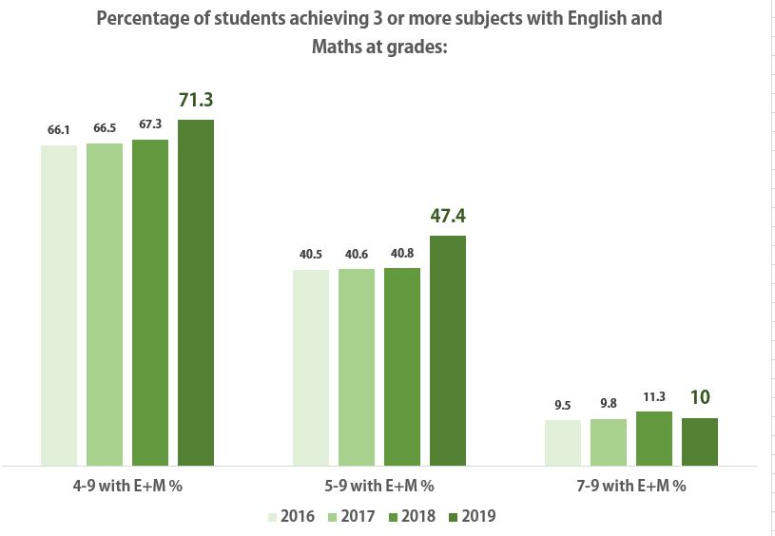
success @yateley

Slide 7
How can parents help?
Parental support is much more important than wealth or social status in aiding success
Establish the right habits and attitudes for success and fulfilment
Reassure and raise aspiration
Providing a suitable place to work independently

Slide 8
Encourage good routines!
Electronic devices off one hour before sleep
Reading for pleasure is a good way to wind down and switch off
Play soft music and dim lights
Avoid arguments (stress), loud music, heavy meals, extreme exercise before bed
Spend 5 minutes clearing a bit of his/her room, organising school bag for the following morning.
Research indicates that young people who have set bed times of 10pm or earlier are less likely to suffer from depression and enjoy greater levels of motivation
Monitor and reduce internet usage

Slide 9
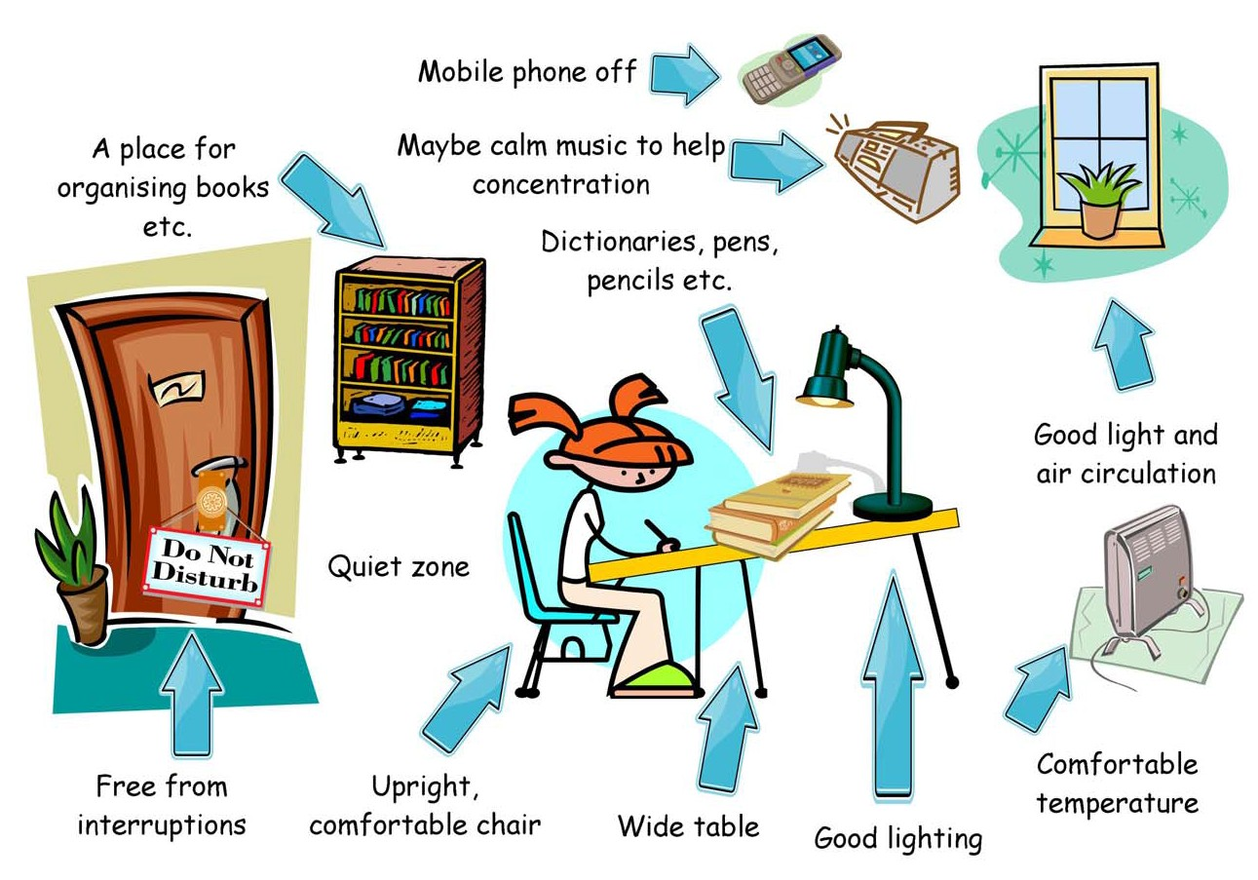

Slide 10
Important points
Take an interest!
Find out how to help
Set the balance between work and social life in agreement. Be flexible.
Students - demotivated/overwhelmed/struggling with demands on time? Listen, empathise and encourage – don’t criticise.
80/20 rule. If your child is sticking to what they are supposed to be doing 80% of the time, they will be doing alright
Encourage a sense of perspective. Growth mindset.

Slide 11
GCSE Course
&
Examination Information
2019 - 2021

Slide 12
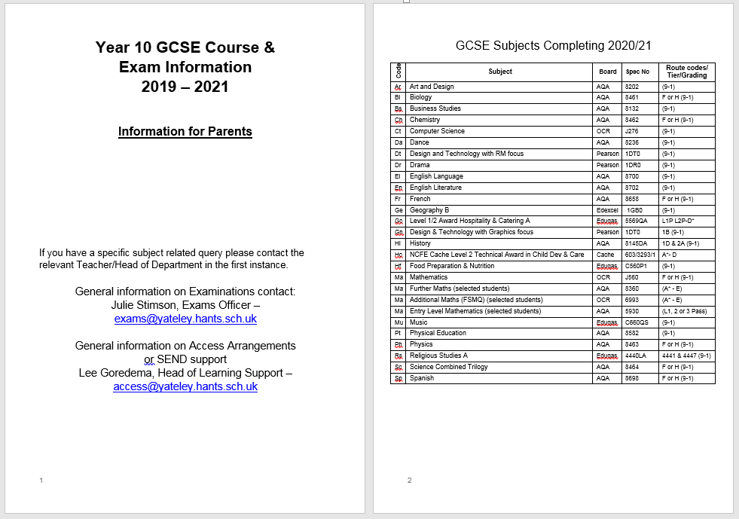
A very useful document to put on your fridge!

Slide 13
Contact Information
Mrs Julie Stimson
Exams Officer
exams@yateley.hants.sch.uk
Mrs L Goredema
Head of Learning Support
access@yateley.hants.sch.uk

Slide 14
WORK EXPERIENCE

Slide 15
Why does Yateley School do Work Experience?
BECAUSE WE KNOW THE IMPACT WORK EXPERIENCE HAS!

Slide 16
Students like Amy Chau has been performing in the English National Opera's production of Noyes Fludde recently.
Mrs Chau wrote to us at Yateley School saying "Amy had a fabulous time performing in Noyes Fludde, and thought the director Lyndsey Turner was brilliant, and had a great time working with her. Thank you for letting her take part in this, and signing it off. This opportunity came as a direct result of sending off for the work experience in Yr 10.
Amy wrote to 5 opera companies, 4 of them gave her different opportunities (she did them all). English National Opera put her on the Baylis programme, which is an outreach programme for 14-18yr olds. At one of the singing workshops they mentioned they might use her in an upcoming production. We heard nothing for 6 months, but then they offered her Noyes Fludde. At the end of the production, the director of music, Martin Fitzpatrick, invited her to audition for the English National Opera Youth Company. We will see what happens!
I would like to thank the school for making Amy do work experience, because as a 14 year old it would not have entered her head to write off to these people off her own will.
She also did a week’s experience at Opera Holland Parks production office, workshops at Glyndebourne Opera, and spent Year 10 in the Youth Company of Garsington Opera Company. That led to performing last summer at the big opera house at John Paul Getty Jnr's estate.
All this happened because she was told to apply for work experience!!"

Slide 17
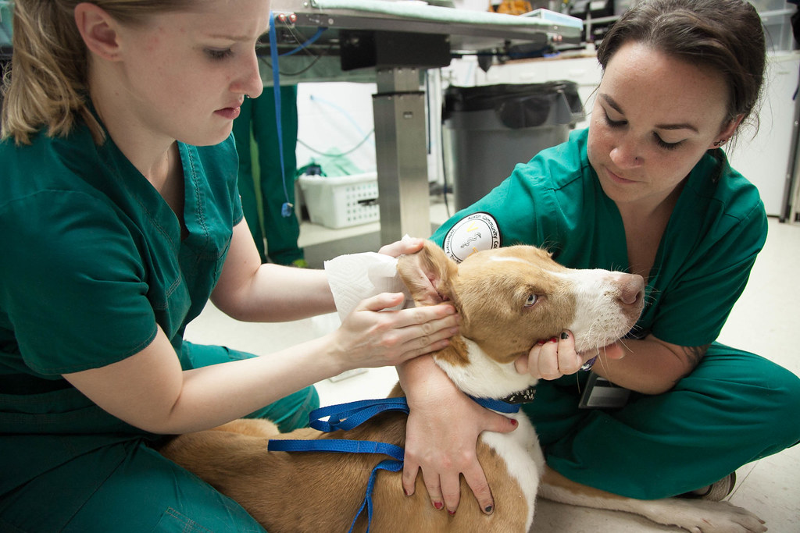
Young people
are more likely to be successful when looking for a career if they have done work experience

Slide 18
If a student has no idea of what they want to do, work experience is a perfect way to sample one or more jobs .
YES...
Our students sometimes do more than one placement in the work experience week!

Slide 19
It’s the best way to get a real sense of a chosen industry.
The student gets to speak to employees and ask them questions
McLaren, Woking

Slide 20
.
Doing work experience shows passion and interest!
Evidence that a student has done work experience shows the employer that they are motivated to get into a chosen career and that they’ve “done their homework.”

Slide 21
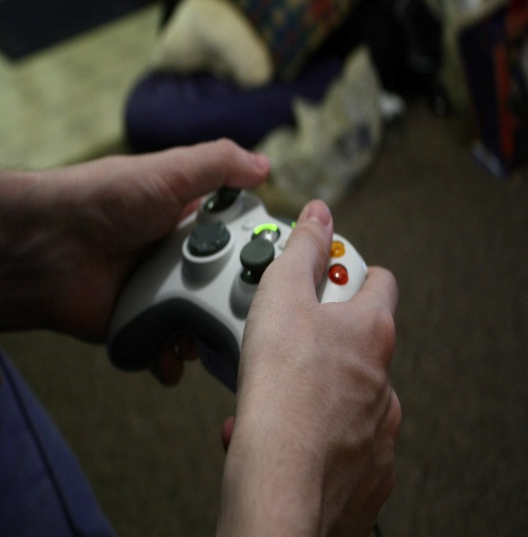
If a student is floundering
and can’t be bothered about their career…
WORK EXPERIENCE might just be the kick start they need!!!

Slide 22
Work experience gently introduces a student to the world of work.
They get to learn the do’s and don’ts,
work hours (not school hours), building their confidence in working with adults, initiating conversations and eye contact, planning their travel to their work placement, time-keeping and getting an idea of the skills they need to thrive in the workplace.

Slide 23
The student might impress them that much that they get a job from it!
Many of our students have been given holiday work from their placements.

Slide 24
We know that it is all about NETWORKING these days.
Work experience will help our students build their contacts and, you never know, they might even be given the heads up about a future job or be recommended to another company for a job!

Slide 25
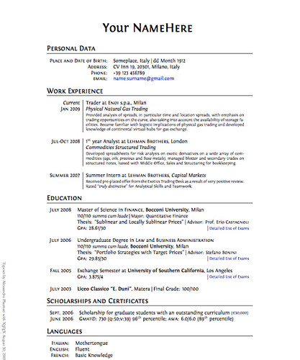
And yes…
Work experience does give our students something to put on their CV!

Slide 26
Mrs Dethick our Work Experience Co-ordinator
will be taking the Year 10 Assembly on
Wednesday 9th October 2019
to launch Work Experience and hand out lots of information.
In the meantime please note that Work Experience will take place from:
Monday 13th July to Friday 17th July 2020
Please start talking to your children about work experience!

Slide 27
Support for Success
Mr B. Coggan

Slide 28
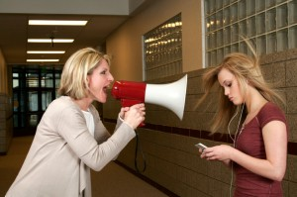
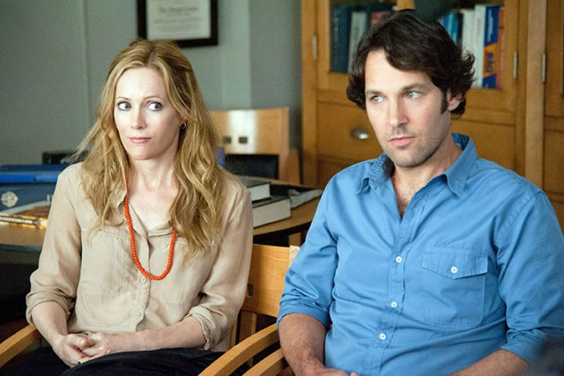
What will the next two years look like?
????
Notes:
Aspirations
Career knowledge and understanding
Know about further education and what is required (including study and apprenticeships)
We need to help them push the barriers, get things wrong, get out of their comfort zone and support them
If they think they can or they think they can’t they are right
Growth mind-set
Time to stand up and take action (the time will fly past)

Slide 29
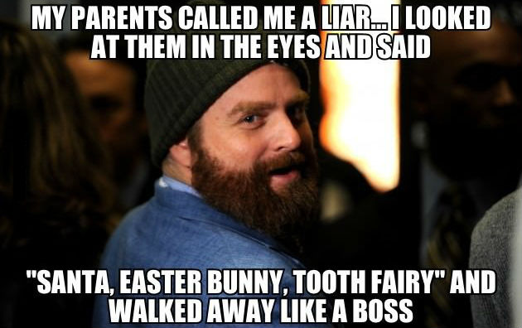
The reality……..

Slide 30
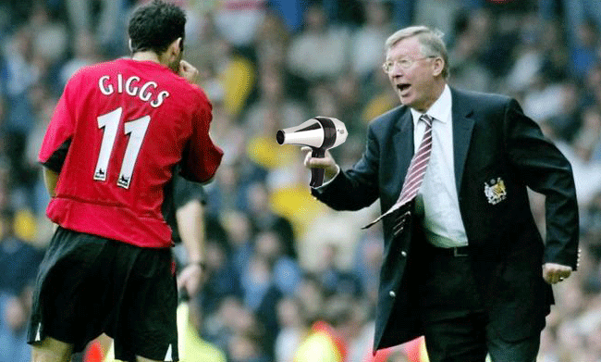
So how do WE support your son or daughter?
There is no one size fits all solution
Some need an arm around the shoulder
Others need the hair-dryer treatment

Slide 31
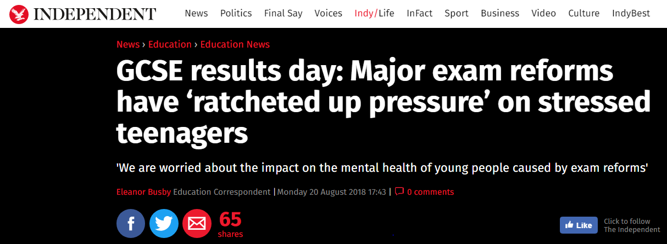
What we do know.
New figures show that Childline gave 2,795 counselling sessions about exam stress in 2018/19 this is almost double the number they gave last year (2017/18 -1,433)
Of these many report being worried about their parents reaction.
We have seen a significant rise in students who find it difficult to cope with stress related to exams and this is reflected nationally

Slide 32
The House Team
Additional Support
The new Wellness Centre.
Learning Support
Staff & Peer Mentoring (subject focus, individual learning skills and emotional well-being)
Counselling.
School Nurse.
External Agencies and Support Services.
Elevate Education - dedicated tutor time focus on study skills and emotional wellbeing.
The Good News!
Subject Specific Support
Subject Teachers.
Heads of Department.
Period 7’s, Catch up sessions and workshops.
Pre-exam Revision Breakfasts.
GCSE the Week Ahead.

Slide 33
Communication is key
Talk about any concerns.
Speak to tutors and subject teachers – first port of call.
Phone, e-mail, write, meet.
Early intervention and support.
Student
Parent
School

Slide 34
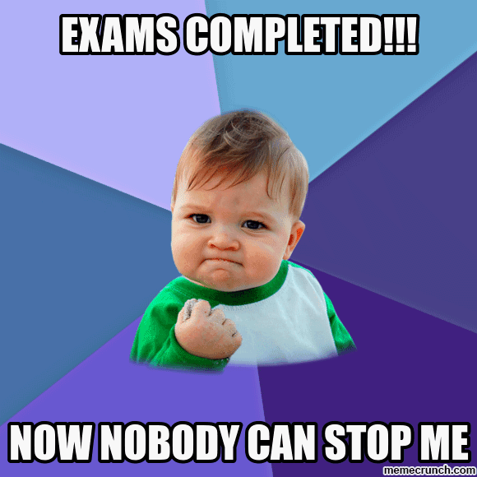
We will get them there!

Slide 35
WHAT WILL YOUR SON/DAUGHTER
BE LIKE DURING THEIR GCSES?

Slide 38
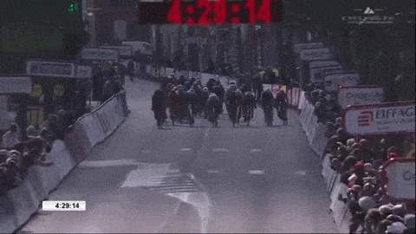

Slide 39
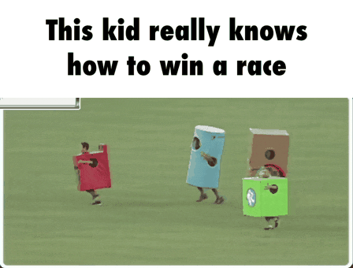

Slide 40
Winning the race.
And how can we help?

Slide 41
IS SHE DOING WELL?
HE

Slide 42
In case you missed it…
Almost everything you probably used to understand is changing!
A Quick Summary:
Grades don’t mean the same thing (Letters are now Numbers)
Achievement is measured differently (Attainment 8)
The perceived “value” of some subject over others has changed (English Baccalaureate, Progress 8, Attainment 8)

Slide 43
What are YOU used to?

Slide 44
English
+
Maths
+
Three other GCSEs

Slide 46
What are students aiming for now?

Slide 47
What’s needed in the future?
English, Maths and 3 or more other GCSEs
“Strong Pass”
P
A
S
S
“Fail”
9
5
4
0

Slide 48
What will the upcoming report look like?
A Target Grade
(shown as a number)

Slide 49
What will your son/daughters report look like?
A current prediction of how they will perform (based on assessment)

Slide 50
What will your son/daughters report look like?
Three “teacher predictions” during the year.

Slide 51
What does the future hold for students who do their GCSEs in 2021?
Things ARE harder… in every subject.
Employers, sixth forms and universities will want to know if they have “at least a 4” in English and Maths…
For more academic A-Levels they may need a grade 5 (or even higher)
Students will need to re-sit Maths and/or English in Sixth Form (should they achieve a 3 or lower)

Slide 52
What can THEY do?

Slide 53
?

Slide 58
Less than half the year group
More than half the year group

Slide 59
A journey of a thousand miles starts with a single step.

Slide 60
Thank you for coming!
Person | Role | Topic
Mr P German | Headteacher | Making the most of KS4/supporting your child
Mr B Coggan | Head of Darwin House | Pastoral support and help in year 10 and 11
Mr M Tidd | Careers | Work experience opportunities and benefits
Mr P Hill | Deputy Headteacher | Academic progress, intervention, support, revision.

