Slide 1
YEAR 9

Slide 2
Slides Content (click on headings to go to slide)
Tutor Guide (how to use this resource)
Tutor Important Notes
Genre Explanation
Year 9 Books – Detailed Slide Per Book:
Steve Jobs: The Man Who Thought Different
Lord of the Flies
Noughts and Crosses
Bog Child
Nineteen Eighty Four
The War of the Worlds
The Poet X
Half Brother
Anita and Me
Trash
Touching the Void
The Woman in White

Slide 3
Tutor Guide
Every tutor session…
Tutor needs to edit their relevant book slide to show the start page number and the start and end page number for that tutor session (based on where they got to last time)
The relevant slide to the book in current use should be displayed by Tutors every day that the book is read.
On the first day of a new book…
Tutors should display the new relevant slide, and simply move through each section of the slide.
Tutors should:
a) tell students who the author is and when it was written
b) read the brief synopsis
c) give details on the setting, themes and genre

Slide 4
Tutor Important Notes
Tutors hold onto their box of books ready for each tutor session.
Tutors need to read the day before the planned reading and annotate their tutor copy (around 4 words per pages to explain)
Tutors should not spend unnecessary amounts of time referring to these slides. They are intended only as an introduction (and daily visual reminder) of key details.
Tutors must ensure that students using their reading bookmarks/rulers in each book to follow the reading with the tutor.
Tutors should only read the slide to students on the FIRST day of a new book. After that, it will remain as a silent visual for the duration of the book.
Tutors should still follow usual guidance and read for the full length of the session, only stopping at the sound of the bell to move to Period 1.

Slide 5
Genre | Explanation
Bildungsroman | deals with one person's formative years / coming of age
Historical fiction | a story where the plot happens in the past
Non-fiction | an information text dealing with actual, real-life things or events
Biography / autobiography | an account of a person’s life/ an account of a person’s life written by themselves
Young adult fiction | a story intended to be written for a young adult audience
Allegory | a story with a hidden meaning; moralistic
Poetry / slam poetry | texts where the expression of feelings/ideas are given intensity with a distinctive style and rhythm
Thriller/ suspense / psychological | a story that creates feelings of suspense, excitement, surprise, anticipation or anxiety for the reader
Fantasy | a story where the plot could not happen in real life. Often involves magic or witchcraft. Takes place on another planet or in another world
Anthology | a collection of poems or artistic works
Genre | Explanation
Crime fiction | deals with crimes, their detection, criminals, and their motive
Parable | a short story with a moral attitude or sharing a religious principle
Fable | uses animals, legendary creatures, plants, inanimate objects, or forces of nature to lead to a particular moral lesson
Horror / gothic | intended to scare, frighten, disgust, or startle its readers through horror and terror
Science fiction | deals with futuristic concepts, advanced science & technology, time travel, parallel universes, space and extra-terrestrial life
Adventure / quest | a journey for a mission or goal. Mythology, folklore & legends often involve quests
Utopian / dystopian | both are used to describe social and political structures in the world. Utopian: a place that we can only dream about, a true paradise. Dystopian: a society in which many things have gone wrong – a dark place.
Epistolary | a novel written as a series of documents. E.g. letter, diary entry, newspaper clipping
Picaresque | an adventure story featuring a rough-and-tumble character who faces lots of events

Slide 6
Steve Jobs: The Man Who Thought Different
Synopsis
Karen Blumenthal takes us to the core of this complicated and legendary man, while also exploring the evolution of computers. Framed by Jobs' inspirational Stanford speech and illustrated throughout with black and white photos, this is the story of the man who changed our world.
Setting
Various locations
Themes
Resilience, hard work, health, life stories
Genre
Biography
Page: ENTER START PAGE #
Karen Blumenthal (2012)
Read from: START & END PAGE #

Slide 7
Lord of the Flies
Synopsis
A group of British schoolboys are stranded on a tropical island. In an attempt to recreate the culture they left behind, they elect Ralph to lead, with Piggy as counsellor.
However, Jack wants to lead too, and one-by-one, he lures the boys from civility and reason to savage survival.
Setting
An unnamed, uninhabited island, Pacific Ocean during a fictional world wide war around 1950
Themes
Civilisation vs savagery, loss of innocence, humankind
Genre
Allegory, young adult fiction, psychological fiction
Page: ENTER START PAGE #
William Golding (1954)
Read from: START & END PAGE #

Slide 8
Noughts and Crosses
Synopsis
Sephy is a cross - a member of the dark-skinned ruling class. Against a background of prejudice and distrust, highlighted by violent terrorist activity by Noughts, a romance builds between Sephy and Callum – a romance that is to lead both of them into terrible danger.
Setting
An alternative universe, 1960’s
Themes
Racial injustice, identity, friendship, love, conflict
Genre
Action, adventure, romance fiction
Page: ENTER START PAGE #
Malorie Blackman (2001)
Read from: START & END PAGE #

Slide 9
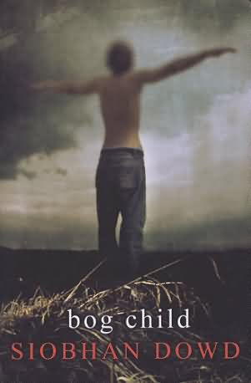
Bog Child
Synopsis
Set in the 1980s amid the backdrop of the Troubles of Northern Ireland, it features an 18-year-old boy who must study for exams but experiences his imprisoned brother's hunger strike, the stress of being a courier for the provisional IRA, and dreams of a murdered girl whose body he discovered in a bog.
Setting
Ireland, 1980’s
Themes
Self-sacrifice, family, political conflict, love, death
Genre
Mystery, historical fiction
Page: ENTER START PAGE #
Siobhan Dowd (2008)
Read from: START & END PAGE #

Slide 10
Nineteen Eighty Four
Synopsis
A nightmarish vision of a dictator-led world and one person’s attempt to find individuality. George Orwell makes a brave comment on modern life – widespread media, the power of language – and has great success in constructing a realistic version of hell. One of the most terrifying novels ever written.
Setting
Oceania, London, Airstrip One, ‘Near future’ 1984
Themes
Communication, viewpoints, power, warfare, manipulation
Genre
Utopian, dystopian, social science fiction
Page: ENTER START PAGE #
George Orwell (1949)
Read from: START & END PAGE #

Slide 11
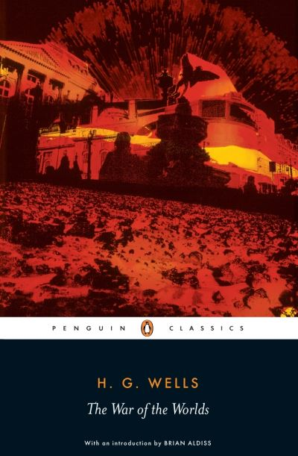
The War of the Worlds
Synopsis
Long before man had learned to fly, HG Wells wrote this story of a Martian attack on England. Unearthly creatures arrive in machines across the country and cause total destruction. The inhabitants of the earth are powerless, and it seems that the end of the World has come. There is one factor, however, that the Martians have not considered.
Setting
England, 1900’s
Themes
‘The other’, rules and order, community, fear, power
Genre
Science fiction
Page: ENTER START PAGE #
HG Wells (1898)
Read from: START & END PAGE #

Slide 12
The Poet X
Synopsis
A young girl in Harlem discovers slam poetry as a way to understand her mother’s religion and her own relationship to the world. In the face of a world that may not want to hear her, Xiomara refuses to be silent.
Setting
Harlem, New York. Present day
Themes
Identity, faith, relationships, independence, words
Genre
Slam poetry, young adult fiction
Page: ENTER START PAGE #
Elizabeth Acevedo (2018)
Read from: START & END PAGE #

Slide 13
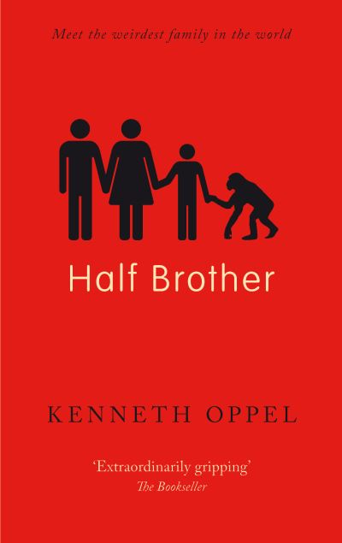
Half Brother
Synopsis
When his father takes a baby chimp into their family as part of an experiment, thirteen year old Ben has to cope with the wrench when the experiment comes to an end.
Setting
Canada. Present day.
Themes
Families, experiments, chimpanzees
Genre
Young adult fiction
Page: ENTER START PAGE #
Kenneth Oppel (2010)
Read from: START & END PAGE #

Slide 14
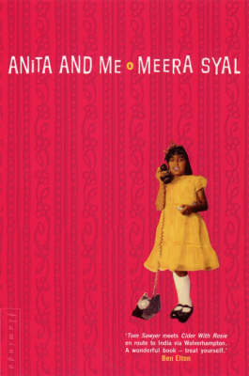
Anita and Me
Synopsis
The story follows the life of nine-year-old Meena Kumar, the daughter of Indian immigrants, as she attempts to define her personal identity, marked by her Indian background and the small-town, English society in which she grows up.
Setting
A fictional English village of Tollington, 1970’s
Themes
Family discipline, friendship, culture, belonging
Genre
Autobiography, comedy-drama
Page: ENTER START PAGE #
Meera Syal (1996)
Read from: START & END PAGE #

Slide 15
Trash
Synopsis
Raphael, Gardo and Rat live on the trash heaps of Behala and sort through it, hoping to find anything they can sell or recycle. Their lives are rugged, poverty stricken, unadventurous. This changes when the boys find something in the trash: a bag, with a key and a wallet.
Setting
The Phllippines
Themes
Poverty, homelessness, corruption, religion, friendship
Genre
Mystery, thriller
Page: ENTER START PAGE #
Andy Mulligan (2010)
Read from: START & END PAGE #

Slide 16
Touching the Void
Synopsis
A heart-stopping account of Joe Simpson’s terrifying journey to the Peruvian Andes. He and his climbing partner reached the summit of the Siula Grande in 1985. A few days later, Simon heard news that Joe was dead. An epic tale of survival and true friendship.
Setting
Siule Grande, Peruvian Andes, 1985
Themes
Friendship, trust, adventure, danger, challenge
Genre
Non-fiction, Autobiography, Documentary, Adventure, Sports
Page: ENTER START PAGE #
Joe Simpson (1988)
Read from: START & END PAGE #

Slide 17
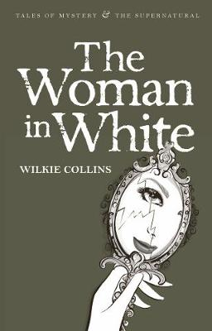
The Woman in White
Synopsis
When the hero, Walter Hartright, on a moonlit night in north London, encounters a solitary, terrified and beautiful woman dressed in white, he feels impelled to solve the mystery of her distress.
Setting
England, mid 1800’s
Themes
Morality, crime, punishment, identity
Genre
Gothic fiction, Mystery
Page: ENTER START PAGE #
Wilkie Collins (1859)
Read from: START & END PAGE #

