Slide 1
YEAR 8

Slide 2
Slides Content (click on headings to go to slide)
Tutor Guide (how to use this resource)
Tutor Important Notes
Genre Explanation
Year 8 Books – Detailed Slide Per Book:
A Long Way Home
A Monster Calls
Chinese Cinderella: The True Story of an Unwanted Daughter
Coram Boy
I am Malala
One
The Giver
Steve Jobs: The Man Who Thought Different
Revolver
Mud, Sweat and Tears
The Invincible Summer of Juniper Jones
The Last Paper Crane
Fahrenheit 451
My Sister Lives on the Mantelpiece

Slide 3
Tutor Guide
Every tutor session…
Tutor needs to edit their relevant book slide to show the start page number and the start and end page number for that tutor session (based on where they got to last time)
The relevant slide to the book in current use should be displayed by Tutors every day that the book is read.
On the first day of a new book…
Tutors should display the new relevant slide, and simply move through each section of the slide.
Tutors should:
a) tell students who the author is and when it was written
b) read the brief synopsis
c) give details on the setting, themes and genre

Slide 4
Tutor Important Notes
Tutors hold onto their box of books ready for each tutor session.
Tutors need to read the day before the planned reading and annotate their tutor copy (around 4 words per pages to explain)
Tutors should not spend unnecessary amounts of time referring to these slides. They are intended only as an introduction (and daily visual reminder) of key details.
Tutors must ensure that students using their reading bookmarks/rulers in each book to follow the reading with the tutor.
Tutors should only read the slide to students on the FIRST day of a new book. After that, it will remain as a silent visual for the duration of the book.
Tutors should still follow usual guidance and read for the full length of the session, only stopping at the sound of the bell to move to Period 1.

Slide 5
Genre | Explanation
Bildungsroman | deals with one person's formative years / coming of age
Historical fiction | a story where the plot happens in the past
Non-fiction | an information text dealing with actual, real-life things or events
Biography / autobiography | an account of a person’s life/ an account of a person’s life written by themselves
Young adult fiction | a story intended to be written for a young adult audience
Allegory | a story with a hidden meaning; moralistic
Poetry / slam poetry | texts where the expression of feelings/ideas are given intensity with a distinctive style and rhythm
Thriller/ suspense / psychological | a story that creates feelings of suspense, excitement, surprise, anticipation or anxiety for the reader
Fantasy | a story where the plot could not happen in real life. Often involves magic or witchcraft. Takes place on another planet or in another world
Anthology | a collection of poems or artistic works
Genre | Explanation
Crime fiction | deals with crimes, their detection, criminals, and their motive
Parable | a short story with a moral attitude or sharing a religious principle
Fable | uses animals, legendary creatures, plants, inanimate objects, or forces of nature to lead to a particular moral lesson
Horror / gothic | intended to scare, frighten, disgust, or startle its readers through horror and terror
Science fiction | deals with futuristic concepts, advanced science & technology, time travel, parallel universes, space and extra-terrestrial life
Adventure / quest | a journey for a mission or goal. Mythology, folklore & legends often involve quests
Utopian / dystopian | both are used to describe social and political structures in the world. Utopian: a place that we can only dream about, a true paradise. Dystopian: a society in which many things have gone wrong – a dark place.
Epistolary | a novel written as a series of documents. E.g. letter, diary entry, newspaper clipping
Picaresque | an adventure story featuring a rough-and-tumble character who faces lots of events

Slide 6
A Long Way Home
Synopsis
One day, after years of searching, Saroo miraculously found what he was looking for and set off to find his family. A Long Way Home is a moving, poignant, and inspirational true story of survival and triumph against incredible odds. It celebrates the importance of never letting go of what drives the human spirit: hope.
Setting
India, Australia
Themes
Family, memory, friendship, technology, survival, poverty
Genre
Autobiography, biography
Page: ENTER START PAGE #
Saroo Brierley (2013)
Read from: START & END PAGE #
Notes:
Year 8

Slide 7
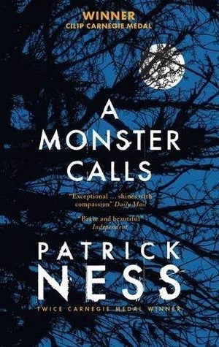
A Monster Calls
Synopsis
Conor is dealing with more than other boys his age. His beloved mother is terminally ill. He has little in common with his grandmother and his father lives thousands of miles away. Each night, he is visited by a monster who tells stories, and guides him on a journey of courage, faith, and truth – a fusion between imagination and reality.
Setting
Present day England (North of UK)
Themes
Death, family, versions of reality, supernatural, suffering
Genre
Fantasy fiction
Page: ENTER START PAGE #
Patrick Ness (2011)
Read from: START & END PAGE #
Notes:
Year 8

Slide 8
Chinese Cinderella
Synopsis
Born as the fifth child to a wealthy Chinese family, her life begins tragically. Adeline's mother died shortly after her birth due to complications brought on by the delivery, marking her as cursed, or 'bad luck', by her siblings.
Setting
Tianjin, China
Themes
Acceptance, perseverance, self-worth, isolation, individual
Genre
Autobiographical novel
Page: ENTER START PAGE #
Adeline Yen Mah (1999)
Read from: START & END PAGE #

Slide 9
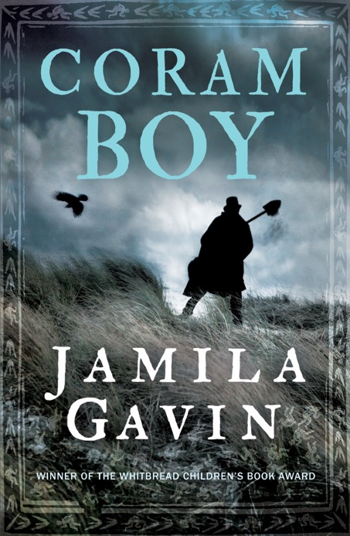
Coram Boy
Synopsis
The Coram Man, Otis Gardiner, roams the country with his son, promising frightened and vulnerable mothers that, in exchange for payment, he would ensure their precious babies were delivered to the Coram Foundling Hospital where a better life awaited them.
Setting
Eighteenth Century England (London & Gloucester)
Themes
Trust, vulnerability, right and wrong, life & death
Genre
Fiction
Page: ENTER START PAGE #
Jamila Gavin (2000)
Read from: START & END PAGE #

Slide 10
I Am Malala
Synopsis
When the Taliban took control of the Swat Valley in Pakistan, one girl spoke out. Malala Yousafzai refused to be silenced and fought for her right to an education. On Tuesday, October 9 2012, when she was fifteen, she almost paid the ultimate price.
Setting
Swat Valley, Pakistan & Birmingham, England
Themes
Power of education, activism, religion, maturity, freedom
Genre
Autobiography
Page: ENTER START PAGE #
Malala Yousafzai (2013)
Read from: START & END PAGE #
Notes:
Year 8

Slide 11
One
Synopsis
Grace and Tippi are conjoined twins who are joined at the waist, defying the odds of survival for sixteen years. They share everything and have never imagine being apart. But things are changing. How long can they hide from the truth before they face the most difficult choice of their lives?
Setting
Hoboken, New Jersey
Themes
Identity, family, friendship, separation, choices
Genre
Young adult fiction, poetry
Page: ENTER START PAGE #
Sarah Crossan (2016)
Read from: START & END PAGE #

Slide 12
The Giver
Synopsis
Jonas lives in a seemingly-perfect world of conformity and contentment. When he begins to spend time with The Giver, an old man who is the sole keeper of the community's memories, Jonas discovers the dangerous truths of his community's secret past.
Setting
Futuristic, small community by a river
Themes
Memory, pain vs. pleasure, the individual
Genre
Science fiction, utopian/dystopian fiction
Page: ENTER START PAGE #
Lois Lowry (1993)
Read from: START & END PAGE #
Notes:
Year 8

Slide 13
Steve Jobs: The Man Who Thought Different
Synopsis
Karen Blumenthal takes us to the core of this complicated and legendary man, while also exploring the evolution of computers. Framed by Jobs' inspirational Stanford speech and illustrated throughout with black and white photos, this is the story of the man who changed our world.
Setting
Various locations
Themes
Resilience, hard work, health, life stories
Genre
Biography
Page: ENTER START PAGE #
Karen Blumenthal (2012)
Read from: START & END PAGE #

Slide 14
Revolver
Synopsis
Sig Andersson is alone, except for the corpse of his father, who died that morning. The cabin is silent, and there's a knock at the door. Sig's thoughts turn to his father's prized possession, a Colt revolver, hidden in the storeroom, just waiting to be used. Should Sig use it, or not?
Setting
1910, a desolate cabin north of the Arctic Circle
Themes
Religion, wealth, truth, violence, family, fear
Genre
Thriller, historical fiction, young adult
Page: ENTER START PAGE #
Marcus Sedgwick (2009)
Read from: START & END PAGE #

Slide 15
Mud, Sweat & Tears
Synopsis
Bear Grylls shares his autobiographical details of his life before his career as the host of Man vs. Wild. This book focuses on his childhood, growing up on the Isle of Wight and other times in his early life.
Setting
Various locations
Themes
Resilience, faith, isolation, power, survival
Genre
Autobiography, biography
Page: ENTER START PAGE #
Read from: START & END PAGE #
Bear Grylls (2011)

Slide 16
The Invincible Summer of Juniper Jones
Synopsis
In 1950's Alabama, a mixed-race teenage boy finds racism and rejection in a small town, except for one accepting resident, and the two embark on a summer like no other.
Setting
1950’s Alabama, USA
Themes
Racism, families, friendship
Genre
Young adult fiction
Page: ENTER START PAGE #
Read from: START & END PAGE #
Dareen McQueen (2020)

Slide 17
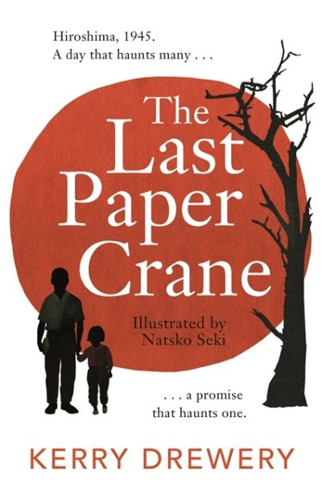
The Last Paper Crane
Synopsis
A survivor of the Hiroshima bombing in 1945 shares his feelings of guilt with his granddaughter after telling her the story of what happened on that day, and subsequent days and years.
Setting
1945, Japan
Themes
WW2, Japan, families
Genre
Young adult fiction
Page: ENTER START PAGE #
Read from: START & END PAGE #
Kerry Deary (2020)

Slide 18
Fahrenheit 451
Synopsis
Set in the 24th century, Fahrenheit 451 tells the story of the protagonist, Guy Montag. At first, Montag takes pleasure in his profession as a fireman, burning illegally owned books and the homes of their owners. However, Montag soon begins to question the value of his job and, in turn, his life.
Setting
America, a future society – the 24th century
Themes
Censorship, ignorance and knowledge, life and death
Genre
Utopian and dystopian fiction
Page: ENTER START PAGE #
Read from: START & END PAGE #
Ray Bradbury (1953)

Slide 19
My Sister Lives on the Mantelpiece
Synopsis
A ten year old boy has to come to terms with the death of his older sister from a terrorist bomb and the break up of his family.
Setting
Present day England
Themes
Families, home, death
Genre
Young adult fiction
Page: ENTER START PAGE #
Read from: START & END PAGE #
Annabel Pitcher (2011)

