Slide 1
YEAR 7

Slide 2
Slides Content (click on headings to go to slide)
Tutor Guide (how to use this resource)
Tutor Important Notes
Genre Explanation
Year 7 Books – Detailed Slide Per Book:
My Family and Other Animals
Peter Pan
Stop the Train
Diary of a Young Girl
The Secret Garden
The Silver Sword
The Weight of Water
Watership Down
Goldfish Boy
Northern Lights
Wonder
The Illustrated Man
Frankenstein (graphic novel)

Slide 3
Tutor Guide
Every tutor session…
Tutor needs to edit their relevant book slide to show the start page number and the start and end page number for that tutor session (based on where they got to last time)
The relevant slide to the book in current use should be displayed by Tutors every day that the book is read.
On the first day of a new book…
Tutors should display the new relevant slide, and simply move through each section of the slide.
Tutors should:
a) tell students who the author is and when it was written
b) read the brief synopsis
c) give details on the setting, themes and genre

Slide 4
Tutor Important Notes
Tutors hold onto their box of books ready for each tutor session.
Tutors need to read the day before the planned reading and annotate their tutor copy (around 4 words per pages to explain)
Tutors should not spend unnecessary amounts of time referring to these slides. They are intended only as an introduction (and daily visual reminder) of key details.
Tutors must ensure that students using their reading bookmarks/rulers in each book to follow the reading with the tutor.
Tutors should only read the slide to students on the FIRST day of a new book. After that, it will remain as a silent visual for the duration of the book.
Tutors should still follow usual guidance and read for the full length of the session, only stopping at the sound of the bell to move to Period 1.

Slide 5
Genre | Explanation
Bildungsroman | deals with one person's formative years / coming of age
Historical fiction | a story where the plot happens in the past
Non-fiction | an information text dealing with actual, real-life things or events
Biography / autobiography | an account of a person’s life/ an account of a person’s life written by themselves
Young adult fiction | a story intended to be written for a young adult audience
Allegory | a story with a hidden meaning; moralistic
Poetry / slam poetry | texts where the expression of feelings/ideas are given intensity with a distinctive style and rhythm
Thriller/ suspense / psychological | a story that creates feelings of suspense, excitement, surprise, anticipation or anxiety for the reader
Fantasy | a story where the plot could not happen in real life. Often involves magic or witchcraft. Takes place on another planet or in another world
Anthology | a collection of poems or artistic works
Genre | Explanation
Crime fiction | deals with crimes, their detection, criminals, and their motive
Parable | a short story with a moral attitude or sharing a religious principle
Fable | uses animals, legendary creatures, plants, inanimate objects, or forces of nature to lead to a particular moral lesson
Horror / gothic | intended to scare, frighten, disgust, or startle its readers through horror and terror
Science fiction | deals with futuristic concepts, advanced science & technology, time travel, parallel universes, space and extra-terrestrial life
Adventure / quest | a journey for a mission or goal. Mythology, folklore & legends often involve quests
Utopian / dystopian | both are used to describe social and political structures in the world. Utopian: a place that we can only dream about, a true paradise. Dystopian: a society in which many things have gone wrong – a dark place.
Epistolary | a novel written as a series of documents. E.g. letter, diary entry, newspaper clipping
Picaresque | an adventure story featuring a rough-and-tumble character who faces lots of events

Slide 6
My Family and Other Animals
Synopsis
This book tells the story of Gerald Durrell’s life, when he lived as a child with his siblings and widowed mother on the Greek island of Corfu between 1935 and 1939. It describes their life in a humorous manner, and explores the fauna (local animals) of the island.
Setting
Corfu, Greek Island. 1935-1939
Themes
The natural world, storytelling, childhood & adulthood
Genre
Autobiography, biography
Page: ENTER START PAGE #
Gerald Durrell (1956)
Read from: START & END PAGE #
Notes:
Year 7

Slide 7
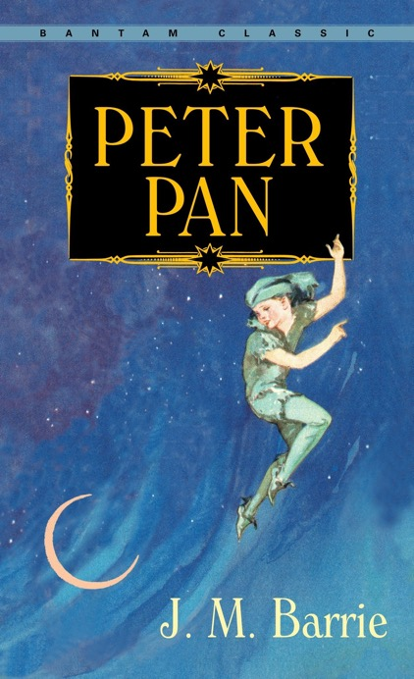
Peter Pan
Synopsis
A mischievous boy who refuses to grow up lands in the Darling's home to look for his shadow. He befriends Wendy, John and Michael and teaches them to fly (using fairy dust). He and Tinker Bell whisk them off to Never-land where they encounter the Red Indians, the Little Lost Boys, pirates and the dastardly Captain Hook.
Setting
Neverland
Themes
Growing up, good over evil, family, identity
Genre
Fantasy fiction
Page: ENTER START PAGE #
Read from: START & END PAGE #
J.M. Barrie (1911)
Notes:
Year 7

Slide 8
Stop The Train
Synopsis
Cissy Sissney and her family have stepped off the train into the new town of Florence, Oklahoma, and start to build a future. However, the president of the railroad says no more trains will stop in Florence -- ever. Without the railroad, the town can't survive. It is up to Cissy and her community to solve the problem.
Setting
Oklahoma, America, 1890’s
Themes
Human nature, community, hard work, commerce & trade
Genre
Historical drama
Page: ENTER START PAGE #
Geraldine McCaughrean (2001)
Read from: START & END PAGE #
Notes:
Year 7

Slide 9
The Diary of a Young Girl
Synopsis
Anne Frank's extraordinary diary, written in the Amsterdam attic where she and her family hid from the Nazis for two years, has become a world classic and a timeless testament to the human spirit. Her story is that of every teenager, lived out in conditions few teenagers have ever known.
Setting
German-occupied Amsterdam, Holland. World War 2
Themes
Adolescence, inward vs. outward self, loneliness
Genre
Autobiography, memoir
Page: ENTER START PAGE #
Read from: START & END PAGE #
Anne Frank (1947)
Notes:
Year 7

Slide 10
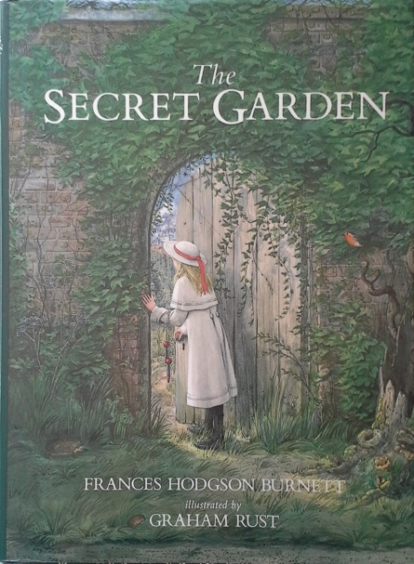
The Secret Garden
Synopsis
Mary Lennox is living in India with her wealthy British family. She is a selfish, disagreeable 10-year-old girl who has been spoiled by her servants and neglected by her unloving parents. When a cholera epidemic kills her parents and the servants, Mary is orphaned.
Setting
Yorkshire, England
Themes
Abandonment, happiness, weakness, isolation
Genre
Fiction
Page: ENTER START PAGE #
Frances Hodgson Burnett (1910)
Read from: START & END PAGE #
Notes:
Year 7

Slide 11
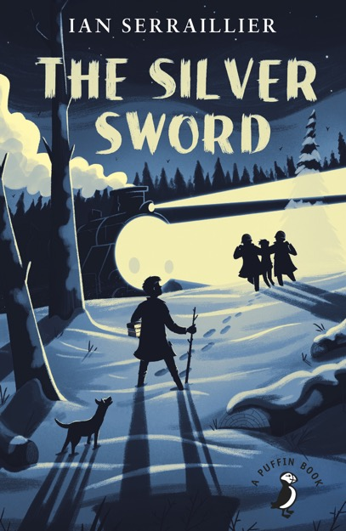
The Silver Sword
Synopsis
The silver sword is a symbol that continues to give Jan and his friends hope. Hungry, cold, and afraid, the four children try to stay alive among the bombed cities in war-torn Europe. Soon, they begin the long and dangerous journey south, where they hope to find their parents again.
Setting
A destructed Europe, after World War 2.
Themes
Courage, survival, good vs. evil, hope, trauma of war
Genre
Historical fiction
Page: ENTER START PAGE #
Read from: START & END PAGE #
Ian Serraillier (1956)
Notes:
Year 7

Slide 12
The Weight of Water
Synopsis
Carrying just a suitcase and an old laundry bag filled with clothes, Kasienka and her mother are immigrating to England from Poland. Kasienka isn't the happiest girl in the world. At home, her mother is suffering from a broken heart as she searches for Kasienka's father.
Setting
Poland, England
Themes
Immigration, alienation, first love, determination
Genre
Bildungsroman, fiction
Page: ENTER START PAGE #
Read from: START & END PAGE #
Sarah Crossan (2011)
Notes:
Year 7

Slide 13
Watership Down
Synopsis
Set in England's Downs, this stirring tale of adventure, courage and survival follows a band of very special creatures on their escape from the intrusion of man and the certain destruction of their home.
Setting
Sandleford Warren
Themes
Home, leadership, nature, escape
Genre
Fantasy fiction
Page: ENTER START PAGE #
Read from: START & END PAGE #
Richard Adams (1972)
Notes:
Year 7

Slide 14
Goldfish Boy
Synopsis
Twelve-year-old Matthew got the nickname The Goldfish Boy because he spends all his time in his bedroom, too afraid to go outside. His obsessive compulsive disorder makes him afraid that he'll bring in germs from the outside world that will make his loved ones sick and possibly die.
Setting
A suburban town, present day
Themes
Obsessive compulsive disorder, family, life & death
Genre
Mystery, fiction
Page: ENTER START PAGE #
Read from: START & END PAGE #
Lisa Thompson (2017)

Slide 15
Northern Lights
Synopsis
Lyra’s best friend is a boy named Roger Parslow whose family works in the college. Together, the two of them plan adventures and battles. There is a rumour going around Oxford that children are being stolen by a mysterious group called “the Gobblers.” Soon after, Roger disappears.
Setting
A parallel universe, the Arctic
Themes
Innocence, morality, identity, fate vs. free will, deceit
Genre
Fantasy fiction
Page: ENTER START PAGE #
Read from: START & END PAGE #
Philip Pullman (1995)
Notes:
Year 7

Slide 16
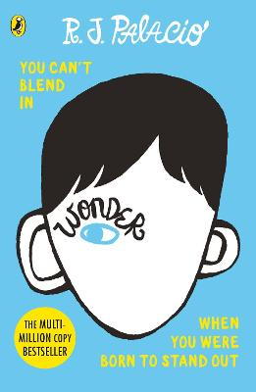
Wonder
Synopsis
August or “Auggie” Pullman, a ten-year old boy living in New York City, was born with a facial deformity that has made it difficult for him to make friends. He lives with his parents, his older sister Via, and his dog Daisy.
Setting
Present day, New York City
Themes
Family, appearance, identity, kindness, courage
Genre
Young adult fiction
Page: ENTER START PAGE #
Read from: START & END PAGE #
RJ Palacio (2012)

Slide 17
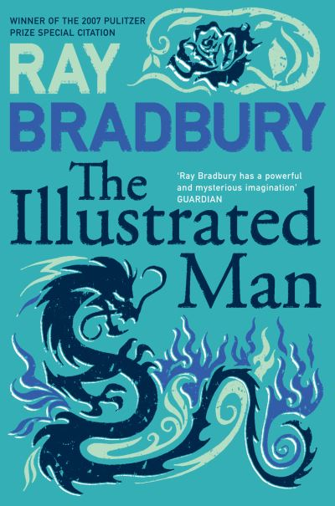
The Illustrated Man
Synopsis
A collection of eighteen short stories that explores the nature of mankind. The unrelated stories are tied together by the frame device of “The illustrated Man”, a vagrant with a tattooed body whom the unnamed narrator meets.
Setting
Various
Themes
Death, imagination, dangers of technology
Genre
Science fiction
Page: ENTER START PAGE #
Read from: START & END PAGE #
Ray Bradbury (1951)

Slide 18
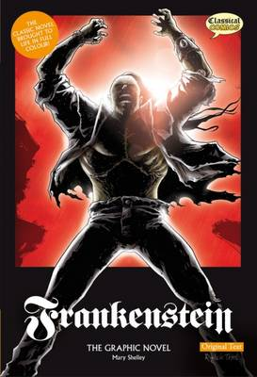
Frankenstein
Synopsis
Victor Frankenstein, a young student of science, is driven by the mad dream of creating his own creature, experimenting with alchemy and science to build a monster stitched together from dead remains.
Setting
Geneva
Themes
Fate, nature, revenge
Genre
Classic fiction
Page: ENTER START PAGE #
Read from: START & END PAGE #
Mary Shelley (1818)
(graphic novel
version 2008)

