Slide 1



Slide 2
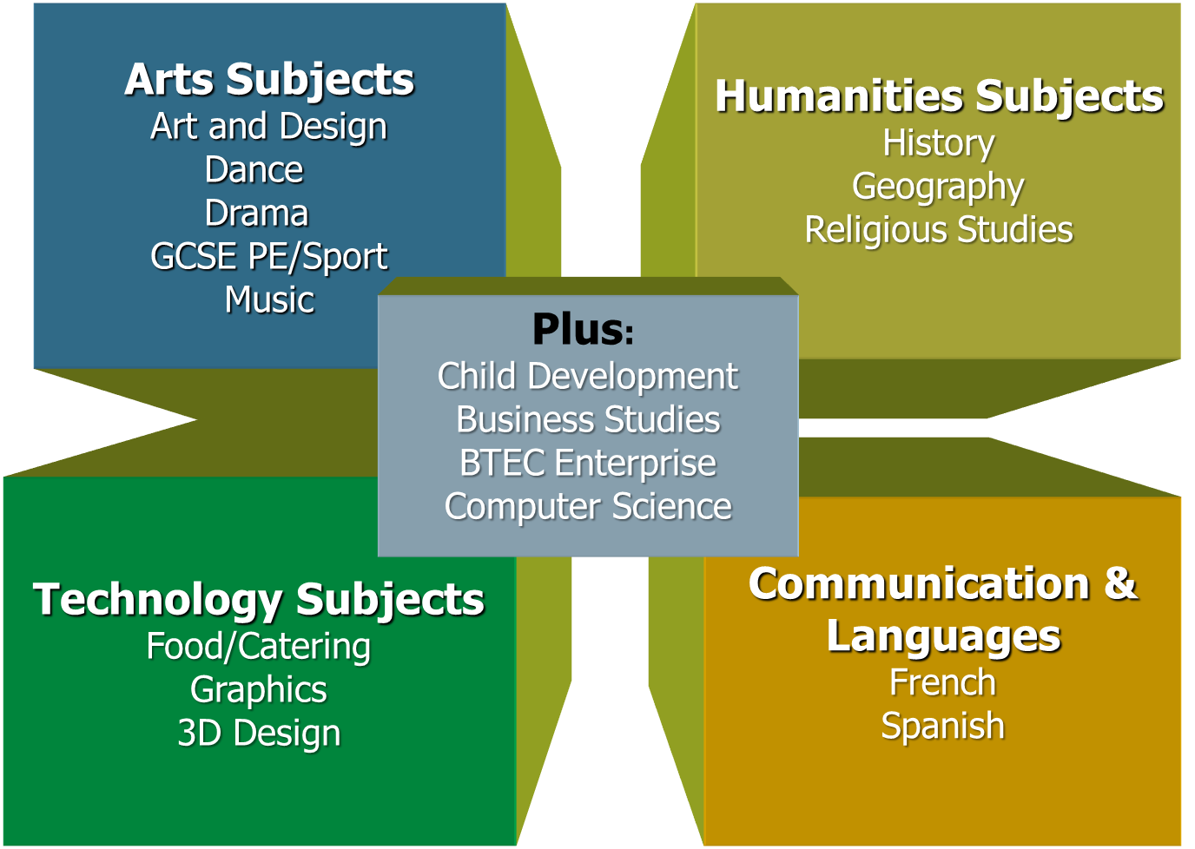
Key dates for your diary
Thursday 23 January
  Subject Review Evening
Friday 24 January to Friday 31 January
  Options Selection (Online)

Slide 3
Exams change…
…but school is still school!

Slide 4
Many of today’s most in-demand jobs didn’t exist in 10 years ago.

Slide 5
Some researchers predict that over half of today’s primary school pupils will hold jobs that don’t yet exist.

Slide 6
Today’s learner will have over 10 jobs by the age of 38.
1 in 4 workers have been with their current employer for less than a year.
1 in 2 have been there less than five years.

Slide 7
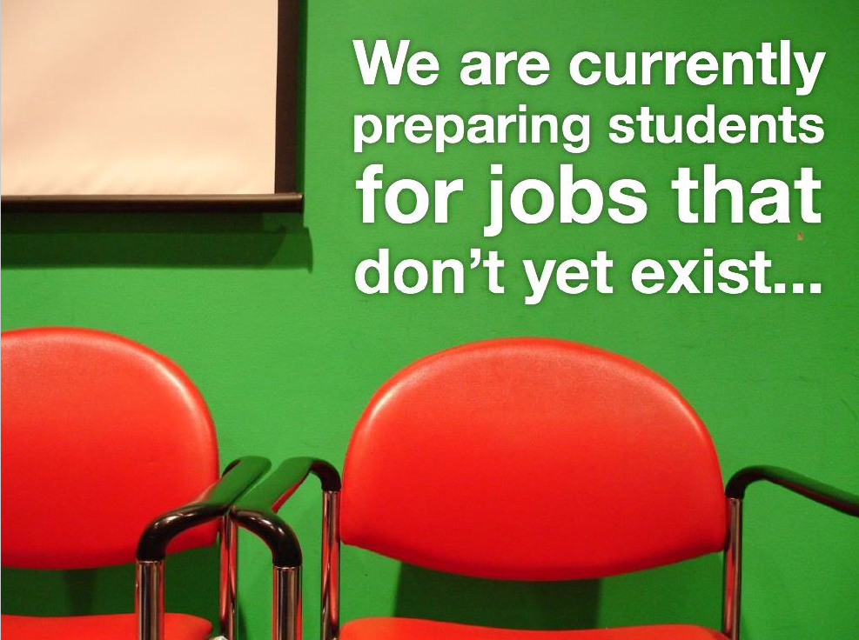

Slide 8


Slide 9


Slide 10
The world beyond Yateley School
Your children will have to remain in Education or training until they are 18.
The Government believes that adults will be 22-23 years old before they embark upon a career.
As adults your children will probably change career 2-3 times during their adult lives and have 10-14 jobs by the age of 38. They will work to the age of 70+ before retirement.
The days of a lifelong career with one company or within one industry have gone.

Slide 11
How are we preparing your children for this uncertain future?

Slide 12
All students at Yateley are entitled to a curriculum that is:
Broad and Balanced
Relevant
Challenging
Enjoyable
Personalised

Slide 13
Subjects your child must take: The Core
English
Maths
Science
PE
Further core elements in PSHE including: Citizenship, Sex and Health education, Finance, decision making and RE

Slide 14
The number of Subjects your child will study…
  1x English Language GCSE
  1x English Literature GCSE
  1x Mathematics GCSE (some may also do Further Maths)
  2 x Science GCSEs (Combined Science) OR
  3 x Science GCSEs (Physics, Chemistry and Biology)
  Core Physical Education
  Core elements of RE, Computing and PSHE
  Plus 4 OPTION courses….

Slide 15
An important point:
Option choices do not depend on what sets a student is in.
All students have the same option choices!

Slide 16
Meeting individual needs
Three separate Sciences and further Maths for some
A bespoke programme with some ‘guided choice’ for a few students for whom a full programme of GCSE courses might not be appropriate.
We will always meet and discuss any bespoke provision with students and parents!

Slide 17
“IT’S HARDER NOW
MUM!”

Slide 18
The ‘new style’ GCSEs
  More rigorous - harder
  Bigger – more content
  Tiers only when necessary
  Linear with terminal exam – little chance to resit (except English and Maths post 16)
  No coursework except in a few subjects (The Arts, Design Technology, Graphics, Food etc.)
  And… a new (ish!) grading system

Slide 19
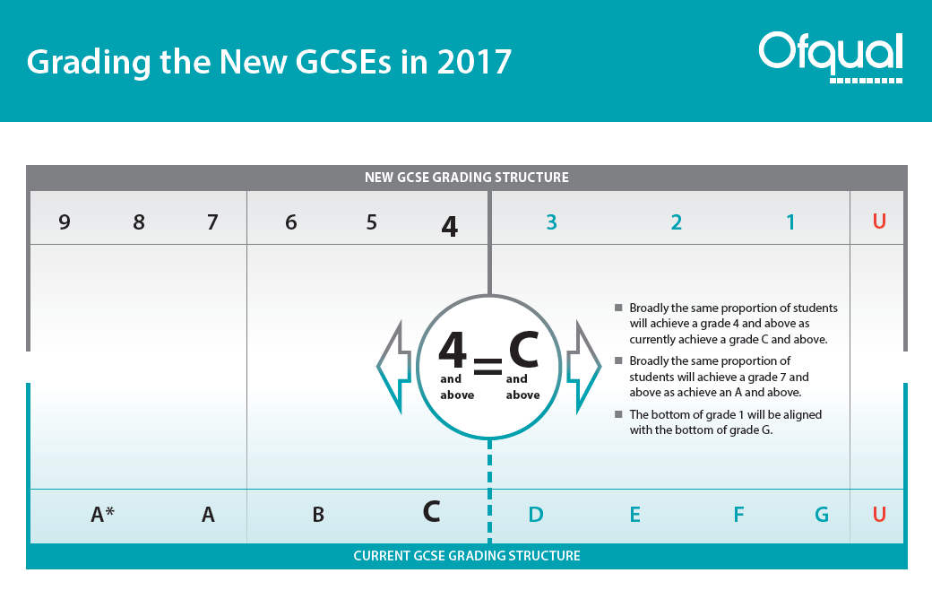
5 = ‘Strong pass’ 4 = ‘Standard pass’
Finer grading at the top end
NEW benchmark?
OLD benchmark

Slide 20
New performance measures
5 or more A* to C including English and Maths is not the main measure of attainment
NOW
Grade 4 (‘standard pass’) and 5 (‘strong pass’) in English and Maths
The EBacc measure - a suite of specific subjects at grade 5 or above

Slide 21
1. Grade 4 and 5 in English and Maths
Grades 4/5 in English and Maths remain a key standard
It will continue to be a key minimum requirement for many courses, apprenticeships & jobs
Grade 5 is aligned with the average performance from high flying countries in international league tables
‘Raising the bar’

Slide 22
2. Progress in the ‘BEST 8’ subjects
The ‘best 8’ is an important measure for both your child and us.
The ‘best 8’ subjects have to include 5 of the EBacc subjects and 3 others
We already do English, Maths and at least two Sciences = 4 Ebacc subjects
Students will need to pick one more.
As a result nearly all our students will now be required to study at least one of:
FRENCH, SPANISH, HISTORY, GEOGRAPHY

Slide 23
2. The Ebacc: it is a performance measure
English Baccalaureate (Ebacc)
  It is a collection of subjects a student can study. Achieved when:
  Grade 5 (or above) in English, Maths, Two Sciences, a Language and either History or Geography
‘The English Baccalaureate (EBacc) is a School performance measure, not a qualification. It is not compulsory’ DfE
Universities have not made the EBacc a part of their admissions criteria nor have any local post-16 providers (including Yateley)

Slide 24
Our view on the Ebacc
We support the idea of a broad and balanced curriculum that has some flexibility to meet the needs and aspirations of all our students
We want students to have choice
Studying the EBacc subjects alongside one of the Arts and a Technology subject would provide breadth and balance
We will not insist on students doing the full suite of Ebacc subjects

Slide 25
however……
Students should consider studying the Ebacc suite of subjects if they are thinking about some higher education courses in the future as they are seen by many as more ‘academic’.
They can study these subjects if they want to.

Slide 26

The Choices

Slide 27
The Four Curriculum Areas
Arts Subjects
Art and Design
Dance
Drama
GCSE PE/Sport
Music
Humanities Subjects
History
Geography
Religious Studies
Plus:
Child Development
Business Studies
BTEC Enterprise
Computer Science
Technology Subjects
Food/Catering
Graphics
3D Design
Communication &
Languages
French
Spanish

Slide 28
Three Pathways
1. Non Specialist
A Humanities
A Language
A Technology
An Arts
2. Specialist
Two from one area
+
Two other choices
3. Work Related
Business/Enterprise
Child Development
Computing Science
Food
Product Design
(Graphics, 3D Design)
GCSE PE/BTEC Sport

Slide 29
Making the Choices
Your child has FOUR choices to make…

Slide 30


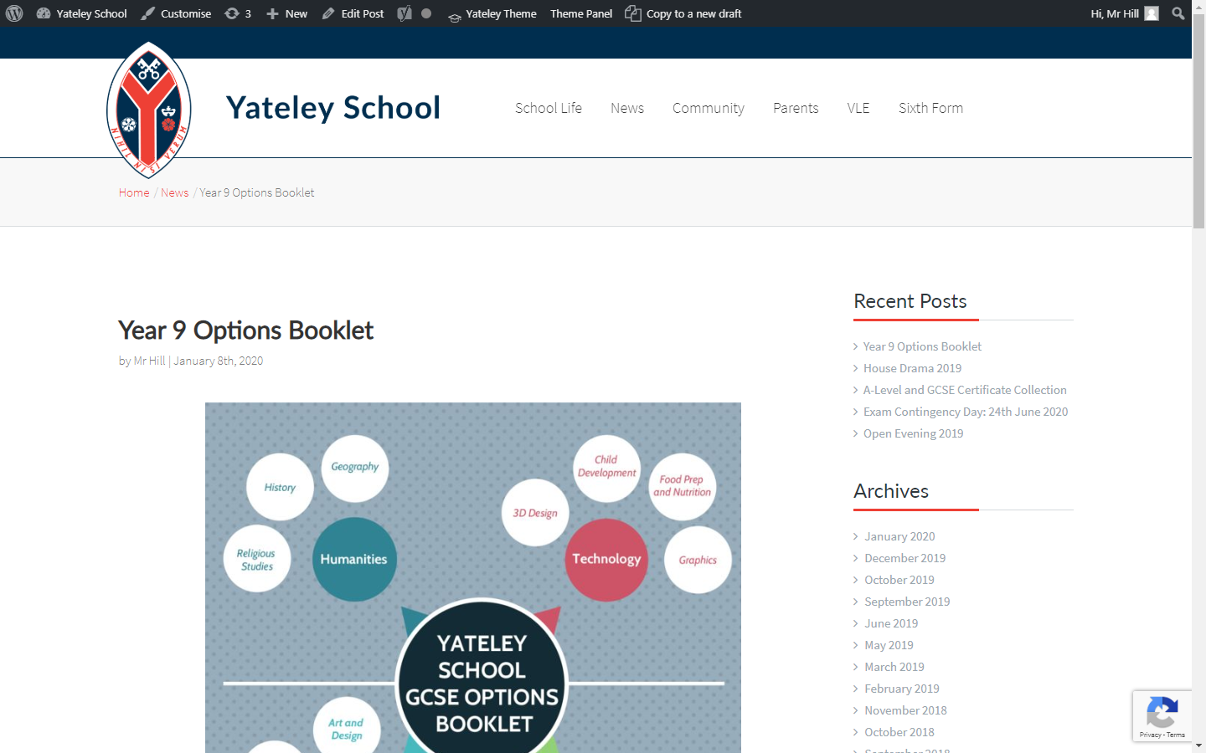

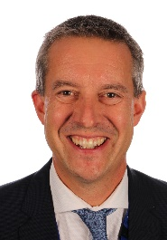
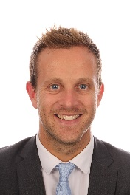
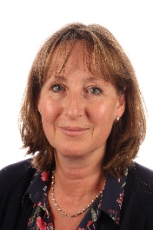

Slide 31


Slide 32



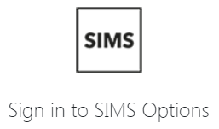
Friday 24 January 2020
Email invite sent to resident parent only
Student and parent receive unique code
Visit SIMS Options Online

Slide 33
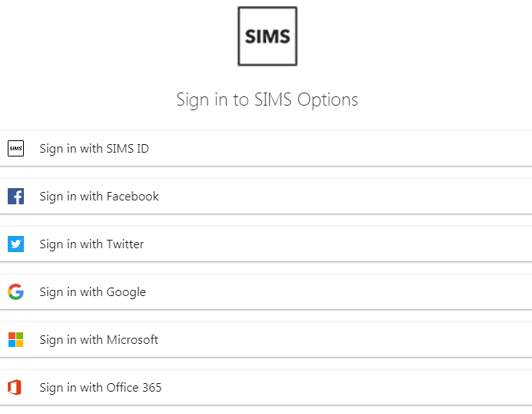

Slide 34
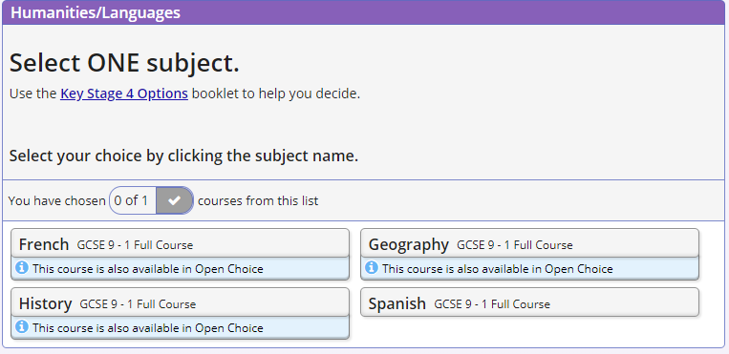

Slide 35
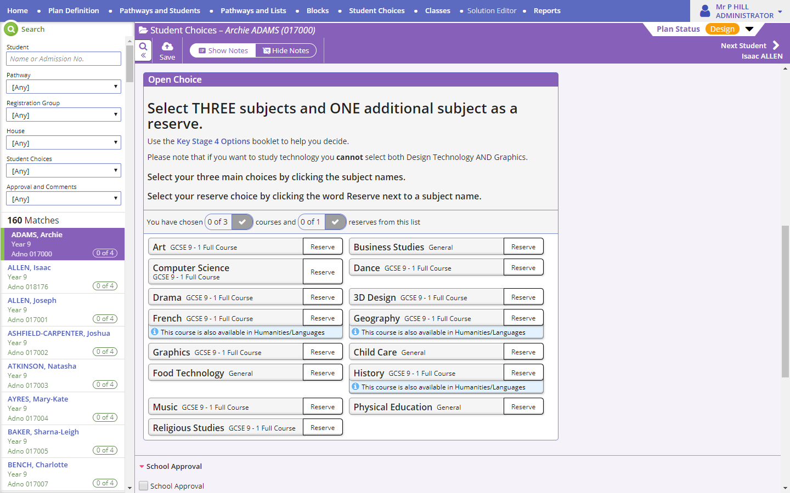

Slide 37
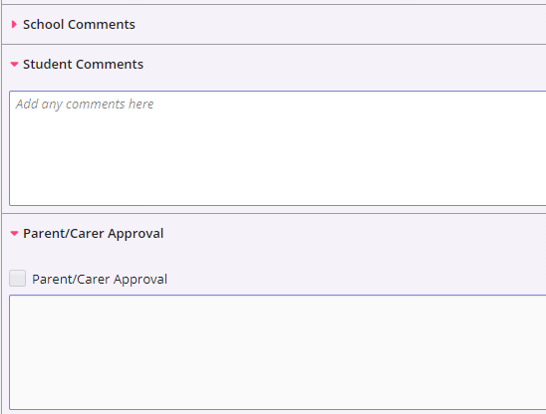

Slide 38
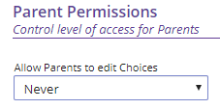

Slide 39
So, just to make things clear...

Slide 40
Subject combinations your child will not be allowed to choose
Food Technology + Catering
Graphics + 3D Product Design
GCSE PE + BTEC Sport
Business Studies + BTEC Enterprise

Slide 41
Subject combinations your child will not be allowed to choose
Students will not be allowed to pick more than two subjects from the same curriculum areas.
You will be told whether your child has been offered:
  the three separate Sciences later in the year.
  An ‘alternative provision’ (in place of some of the option choices) in the next 3 to 4 weeks

Slide 42
A Word of Caution…
When your child is picking their option subjects, it is essential that they pay attention to the skills required to do well in that course.
This is particularly true for subjects like Computer Science, PE and the Performing Arts!

Slide 43
For example:
Computer Science requires them to be able to think logically, solve problems and have a keen attention to detail. They’ll need to be quite good at Maths to do well in Computer Science.
Dance has a requirement to perform. They must be committed to this aspect of the course.
GCSE Physical Education will involve the study of human biology and socio-cultural influences on sport.

Slide 44
Other Information
Occasionally we cannot offer your child all of their first choices so we have asked them to make a reserve choice on the SIMS online platform.
If a course is oversubscribed your child will be selected on the basis of:
Meeting the options deadline, good attendance, good behaviour, possible career path, subject report.

Slide 45
And a word of advice
Students need to keep their options open
It is possible to take most A-levels in subjects if they have not studied them at GCSE level.

Slide 46
Who can your child ask for help?
Tutor – one to one interviews
Subject Teachers
Head of House
Careers Adviser (Rachel Jones/Christine Mirtle)
Learning Support
Parents
They should read the relevant pages of the Option Book!
There will also be talks in lessons and ‘New Subject’ Assemblies

Slide 47
ROLE OF THE PARENT
Mrs Williams

Slide 48
Role of the parent
Support
Guidance – who to talk to
Informed – understand the process and implications
Work with us
Ensure online form is completed by Friday 31 January.

Slide 49
What should influence choice?
Enjoyment
Talent
Career
Balance
Recommendation

Slide 50
Take care!
Your child should not be influenced by:
Friends
Liking a teacher
Thinking that any course is easy… they are all demanding

Slide 51
What’s next?
One-to-one interviews start
Careers activity in form room
Subject talks in lessons
‘New’ subject Assemblies
Careers interviews (Marlene Simms – by appointment)
Subject Review Evening 25th January

Slide 52
SUBJECT REVIEW EVENING
Thursday 23 January
MAKE APPOINTMENTS USING OUR ONLINE BOOKING SYSTEM

Slide 53
SUBJECT REVIEW EVENING
Thursday 23 January
MAKE APPOINTMENTS USING OUR ONLINE BOOKING SYSTEM
Problems getting an appointment?
Email:
department@yateley.hants.sch.uk
Don’t forget the ‘New’ Subjects

Slide 54
New Subjects
SUBJECT | WHO TO SEE
BUSINESS STUDIES | Miss Nicholson
CHILD CARE | Mrs D’Alton
COMPUTER SCIENCE | Mrs Cobbold
DANCE | Mrs Wearing
FOOD / CATERING | Food Teachers
GRAPHICS | Ms S Williams
3D PRODUCT DESIGN | Mr Sibbald
GCSE PE / BTEC SPORT | Mrs Evans, Mr Plummer
All other courses can be discussed with the relevant subject teacher

Slide 55
And remember...
Your child shouldn’t make up their mind straight away, there is plenty of time.
And they need to ask if they are not sure about anything

