Slide 1
Year 11
Mock Results Assembly

Slide 2
Crashing out?

Slide 3
Running out of steam?

Slide 4
A little too confident it’s all fine?

Slide 5
Worked hard… but didn’t succeed?

Slide 6
Miraculously OK?

Slide 7
Absolutely nailed it?

Slide 8
HOW DO YOU FEEL?

Slide 10
Year 11
Mock Results Assembly
Mr German

Slide 11
SOME
CONGRATULATIONS
AND WELL-DONE TO…

Slide 12
Highest Achievers:

Slide 13
Highest Achievers:
CONGRATULATIONS
Isabelle Cole
Ciaran Donegan

Slide 14
Best Progress:

Slide 15
Best Progress:
CONGRATULATIONS
Isabella Boland
Oliver Dart

Slide 16
Year 11
Mock Results Assembly
Mr Macdonald-Parry
English

Slide 17
2020
Year 11 Mock Results Assembly
English

Slide 18
Thank you!
Thank you!
Thank You…

Slide 19
Language
2019 Exam Paper Paper 2 Non-Fiction
Section A Reading:
Different questions require different answers!
Section B Writing:
25% of your GCSE!
----------------------------------------------------------------------------------------------
More practice, more exemplar answers = more success
(Paper 1 Fiction requires a similar discipline)

Slide 20
Results: English Language
4+ 189/220 86%
5+ 125/220 57%
6+ 83/220 38%
7+ 45/220 20%

Slide 21
Literature
2018 Exam question Paper 1 Section B
Jekyll and Hyde (Section A Romeo and Juliet)
Same path to success
Use the extract more fully to write about ideas, language and context
Know the structure of the story to explore significant moments
-------------------------------------------------------------------------------------------------
Paper 2 – Modern Drama, Power & Conflict Poetry, Unseen Poetry

Slide 22
Results: English Literature
4+ 193/220 88%
5+ 136/220 62%
6+ 83/220 37%
7+ 46/220 21%

Slide 23
The next steps?
Keep working hard – every lesson counts!
Make the most of lesson time…
Work with your teachers…

Slide 25
Year 11
Mock Results Assembly
Mrs Shore
Maths

Slide 26
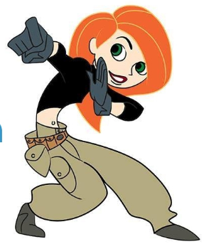
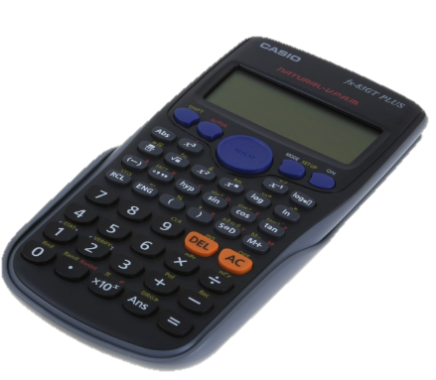
Mathematics
January 2020 Mock

Slide 27
Class of 2020 – GCSE?
Class of 2019 - Mocks
Class of 2019 - GCSE
Class of 2020 - Mocks
80%
70%
Best year!
60%
50%
Even better?
Students at grade
40%
30%
20%
10%
0%
Grade 4+ Grade 5+ Grade 7+ Grade 9
Mathematics Mock 1
2019
2020

Slide 28
Is it too late?
Mathematics
January 2020 Mock

Slide 29
Class of 2018-2019
30 students went from Grade 1-3 to Grade 4+
63 students went from Grade 1-4 to a Grade 5+
33 students went up by 2 grades or more
Highest climber went from a Grade 5 to a Grade 8
NO!
Is it too late?
Is it too late? NO!

Slide 30
What can I do?
Mathematics
January 2020 Mock

Slide 31
What do you do NOW?
3 steps to Maths GCSE success
1. Understand
Engage, question and challenge yourself - every lessons from NOW
Little and Often ….
20 minutes a day Monday – Friday
Have the weekends off ☺
2. Recall
Homework/Revision/Period 7 - 50 minutes every week from NOW
3. Replicate Skill-Up/Practice Papers/Period 7 - 30 minutes every week from NOW
Prepare yourself well and follow our guidance

Slide 32
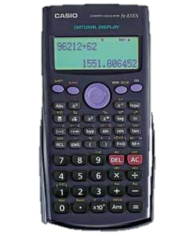
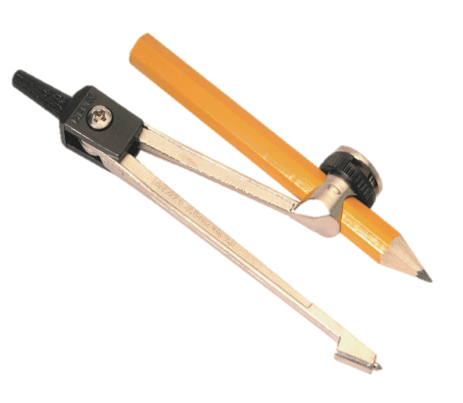
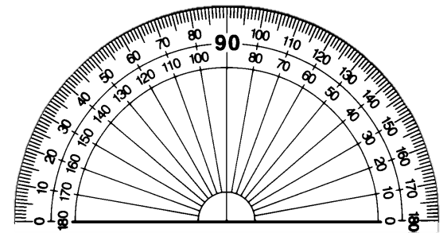
Would you like to gain an extra 30 marks?
Become best friends with your Maths Equipment

Slide 33
… do it NOW!

Slide 34
Who’s awesome?
Mathematics
January 2020 Mock

Slide 35
Joseph Day
Charles Rhodes-Peel
Daniel Mansfield
Taylor Worrall
Prajwal Vadicharla
Katie Boorman
Isabelle Cole
Megan Scotford
Daniel Morgan
Khusbu Rai
Jack Benyon
Harry Harris
Maddie Winston-Bray
Isabella Harlock
Lucy Baxter
Ivan Kuan
Grace Harrison
Samuel Turner
Libby Sage
Sam Drew
Charles Gardiner
Molly Cole
Sophie Green
Katie Green
Ellina Cherry
Eddie Mullins
Megan Jensen
Finlay Turner
Amisa Tamang
Isaiah Mallet
Kylan Ingram
Holly Humphries
Jorja Hodgkins
Benjamin Kirwin
Eloise Gadsby
Isabelle Eldred
Rebecca Rawlinson
Caitlin Milsom
Kin Lau
Ellie Giles
Jake Mitchell
Alice Taylor
Isabella Boland
Layla Tull
Daniel Kennedy
Jai Gautam
Harrison Tonks
Sadie Hales
Daniel Harris
Haaris Haseeb
Ellie Harrington
Sean Treacy
Libby Smith
Matthew Cronk
Phoebe Shea
Ciaran Donegan
Amy Capp
Alexander Bufton
Euan Lowther-Allais
Lewis Lanek
Benjamin Elsey
Sophie Guttridge
Isabelle Gill
Samantha Hart
Oliver Dart
Mia Spicer
Harvey Rentall-Sisk
Rachel Plowman
Joshua Allan
Jayden Yeboah
Ella Reed
Markus Massiah
Gemma Charlton
Abbie Wright
Matthew Collins
Luke Cherry
Edward Van Oostrum
Leah Simpkins
Lauren Jones
Archie Simmons
Charlie Fleming
Freddie Rutter

Slide 36
Year 11
Mock Results Assembly
Mr Stacey
Science

Slide 37
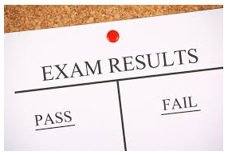
Y11 Science Mock Results…
 | 4+ | 6+ | 7+ | 9
2018 Mocks | 72% | 26% | 13% | 3%
2018 GCSEs | 82% | 31% | 18% | 3%
2019 Mocks | 74% | 26% | 12% | 3%
2019 GCSEs | ?? | ?? | ?? | ??
Highlights:
Y10 double students have improved by a grade in a term!
14 grade 9s awarded
67 students (31%) beat their target in the mock !
Focus areas:
Double variation between subjects (e.g. 8 vs 5, 7 vs 4)
Mock to GCSE progress for higher grades

Slide 38
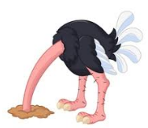
It is not too late…
You can still make a huge difference. 2019 results included:
11 in mock increased to 44 in the real exam
55 in mock increased to 76 in the real exam
5 in mock to 8 in the real exam
7 in mock to 9 in the real exam
If you have not achieved the grade you want
you need to do something different
You need to make the decision

Slide 39
Key revision points…
The mocks covered half of the specification.
The other half is in the March mocks. There is more to do!
Double science is two GCSEs. Treble Science is three GCSEs.
You need to be doing more revision for Science than for one GCSE subjects.
Biology, Chemistry & Physics ‘clinics’ run every week at lunch and afterschool.
Use them to get help.
Coursework and revision are equally important.
If you spend an hour after school doing coursework make sure you spend equivalent time revising i.e. 1 hour of coursework means 2 (or 3) hours of Science revision.

Slide 40
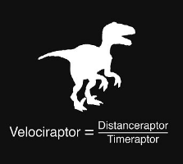
Key revision points…
Maths skills:
30% of Physics, 20% of Chemistry & 10% of Biology
Required practicals:
25% of marks
Physics equations:
guaranteed to be needed

Slide 41
What do you need to do ?
Focus & effort…
in class & independently
work together
If you can’t do it yet…
don’t give up
ask your friends for help
ask your parents for help
ask your teacher for help
Revise…
Flashcards (Q & A)
KnowIt & GraspIt
Past Paper Questions
Free Science Lessons (boring Shaun !)

Slide 42
Year 11
Mock Results Assembly

Slide 43
PERFORMANCE

Slide 44
MOTIVATION

Slide 45
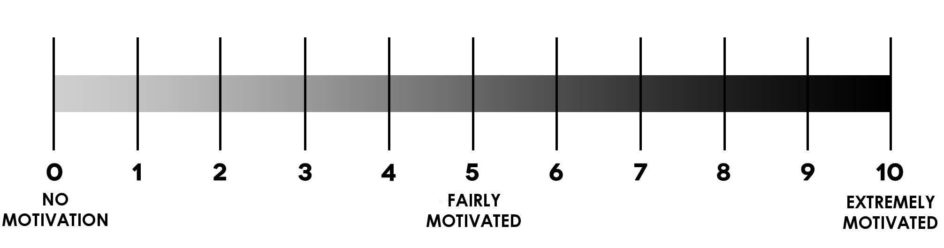
MOTIVATION
HOW HARD DID YOU TRY?
/10

Slide 46
ABILITY

Slide 47
ABILITY
WHAT ARE YOU
CAPABLE OF?
VERY LOW ABILITY
AVERAGE ABILITY
VERY HIGH ABILITY
/10

Slide 48
MOTIVATION
X
ABILITY

Slide 49
MOTIVATION x ABILITY
6 x 8

Slide 50
6 x 8
= 48

Slide 51
MOTIVATION x ABILITY
48/100
=
YOUR
PERFORMANCE

Slide 52
What is this number?
That’s your PERFORMANCE level,
compared with others.
That’s what you’re
WORTH in the real world.
And the “real world” is
getting CLOSE…

Slide 53
100%

Slide 54
40%

Slide 55
60%

Slide 56
“I care, and I’m upset with my results”
“I don’t care”
“I don’t care”
(I do care, but it’s easier to pretend I don’t so I look in control but I’m actually panicking)
I actually don’t care.
60%

Slide 57
HOW DO YOU FEEL?

Slide 58
COMMON ANSWER
#1

Slide 59
“I didn’t try for my mocks, but I will try for the real thing”
Yeah – you and every other Y11 in the country!

Slide 60
YOU JUST MISSED THE CHANCE OF A LIFETIME

Slide 61
YOU'VE TAKEN A BIG RISK.

Slide 62
AND YOU CAN'T TAKE IT BACK

Slide 63
COMMON ANSWER
#2

Slide 64
“Everyone does better in the exams than they do in mocks”

Slide 65
YOU SURE ABOUT THAT?

Slide 66
Last
year…

Slide 67
141
students
did better
in their GCSE exams

Slide 68
91
students
did worse
in their GCSE exams

Slide 69
Exam Results Compared with Mocks
2014
2015
2016
2017
2018
2019
2020
?
Above/Below Targets by…
-1.5 -1.0 -0.5 0 0.5 1.0 1.5
MOCKS PERFORMANCE
GCSE PERFORMANCE

Slide 70
MOTIVATION
X
ABILITY

Slide 71
ONE WEEK

Slide 73
BORN

Slide 74
(congrats btw)

Slide 75
ONE YEAR OLD!

Slide 76
NOT QUITE ONE YEAR OLD!

Slide 77
STARTED PRIMARY SCHOOL!

Slide 78
SIX
(AND A HALF)

Slide 79
YOU STARTED AT YATELEY

Slide 80
STARTED GCSE IN YEAR TEN!

Slide 81
MOCK EXAMS

Slide 82
TODAY!

Slide 83
NEXT?

Slide 84
TIME LEFT
16 WEEKS
TO GCSEs

Slide 85
EXCEPT
IT ISN'T

Slide 86
TIME LEFT
13 WEEKS
IN SCHOOL

Slide 87
TIME LEFT
13 WEEKS
IN SCHOOL
(
)
MINUS the subject review day
MINUS the INSET day
MINUS the bank holiday

Slide 88
EXAMS

Slide 89
HOLIDAY
AND IT IS A GREAT HOLIDAY!

Slide 92
RESULTS DAY

Slide 93
PRETTY
IMPORTANT

Slide 94
WHAT HAPPENS
NEXT

Slide 96
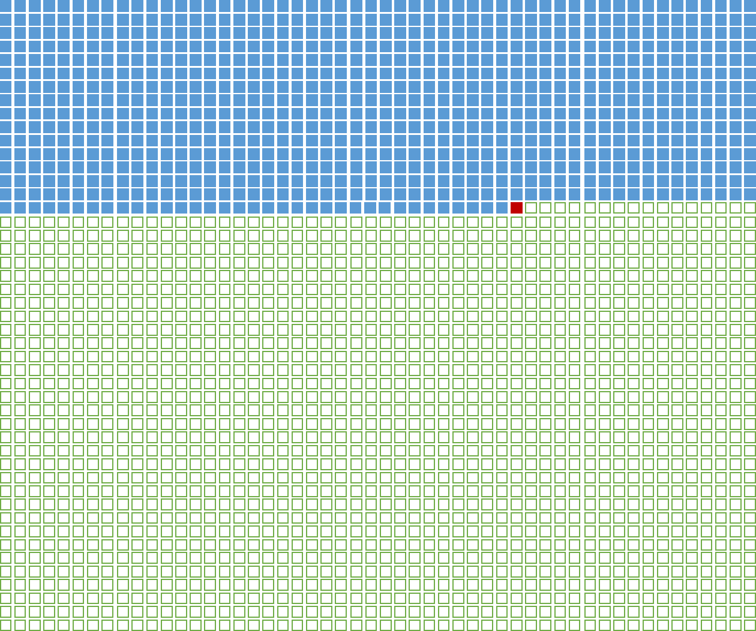
THIS IS THE REST OF YOUR LIFE.

Slide 97
16 WEEKS

Slide 99
MOTIVATION
X
ABILITY
= ?

Slide 100
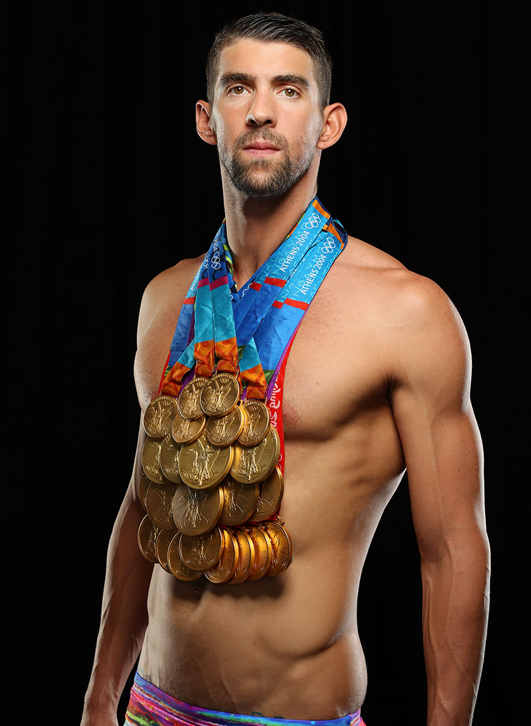

Slide 101
Help!
Attend Elevate Education
Revise Early!
Take past papers
BEHAVE
Meet deadlines
School Attendance
100%
P7 ATTENDANCE
IS 83%
Complete homework
Talk to your teachers!

Slide 102
MORE Help!
Use the library revision facilities open to you!
The ‘Excellence group’ inspiring you to get those top grades
Time set aside for exercise and socialising.
Your tutors who can help with almost anything. Just ask!

Slide 103
WORK HARDER.

Slide 104
GIVE MORE.

Slide 105
KNOW YOU CAN IMPROVE.

Slide 106
BECAUSE NOTHING WORTH HAVING

Slide 107
COMES EASILY.

Slide 108
THIS IS YOUR STORY
#makeitcount
#16weeks

