Slide 1
Yateley School

Slide 2
What is Unifrog?
Unifrog is a one-stop-shop where students can easily explore their interests, then find and successfully apply for their next best step after school.
Unifrog will help you to explore your key interests and what career paths you can take to reach your goals!

Slide 3
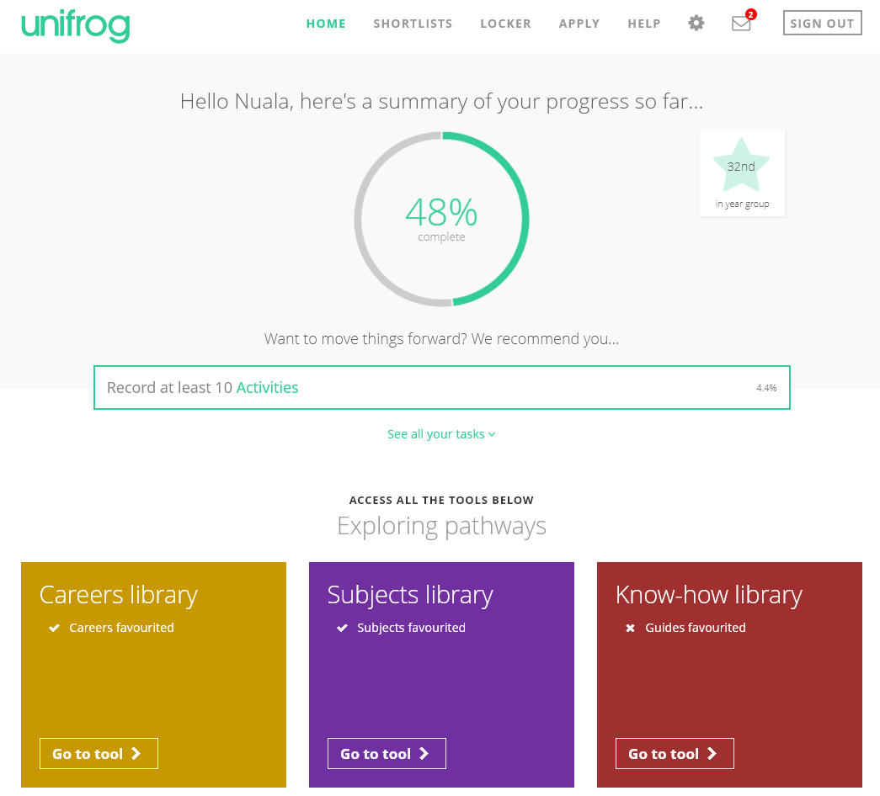
By the end of today’s session, we will have:
Understood how Unifrog can support your future decision-making and career options.
Explored some of the exciting features of the platform.
Created your very own personal Unifrog accounts!

Slide 4
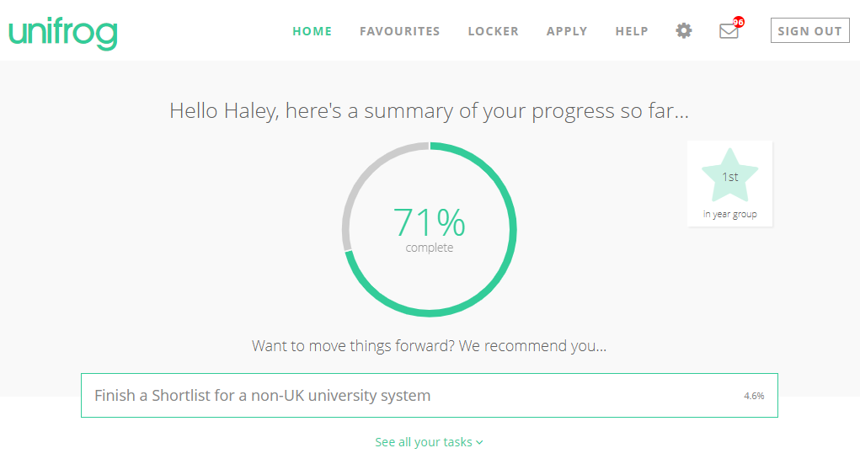
Introduction to Unifrog for Y7-9 / P7-S2
Notes:
Teachers’ notes
Delete slide 4/5 as appropriate
Video – 12 minutes – Audio required
Here’s a handy video taking KS3/Y7-9/P7-S2 students on a tour of the platform! Holding Ctrl and clicking the image will take you to the Loom website to play the video.

Slide 5
Introduction to Unifrog for Y10-11 / S3-4
Notes:
Teachers’ notes
Delete slide 4/5 as appropriate
Video – 13 minutes – Audio required
Here’s a handy video taking KS4/Y10-11/S3-4 students on a tour of the platform! Holding Ctrl and clicking the image will take you to the Loom website to play the video.

Slide 6
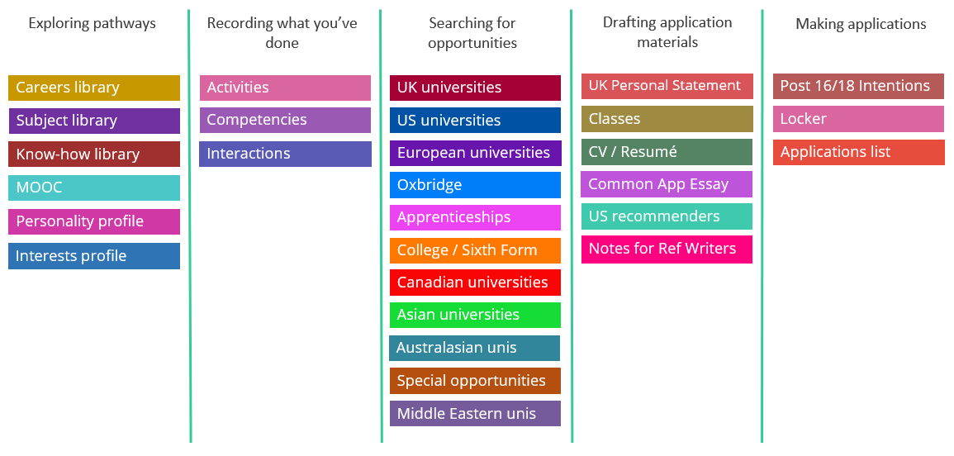
Available resources

Slide 7
Exploring pathways
Use the tools in the Exploring pathways section to research the career pathways and subject fields that lie beyond school or college, and understand how to access them.

Slide 8
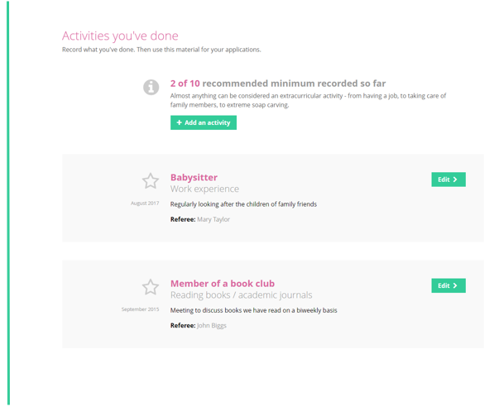
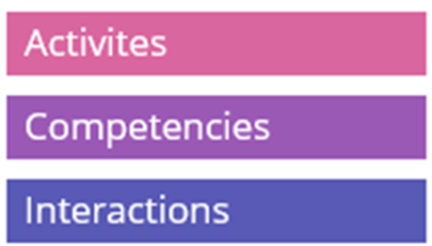
Recording what you have done
Use the tools in this section to start Recording what you have done, using guidance and examples to prepare yourself for making applications.

Slide 9
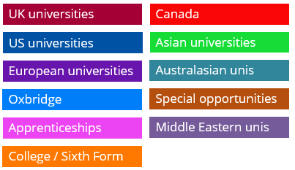
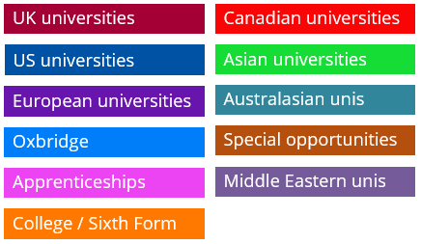
Searching for opportunities
Use the tools in the Searching for opportunities section to compare universities, degree options, apprenticeships and college courses.

Slide 10
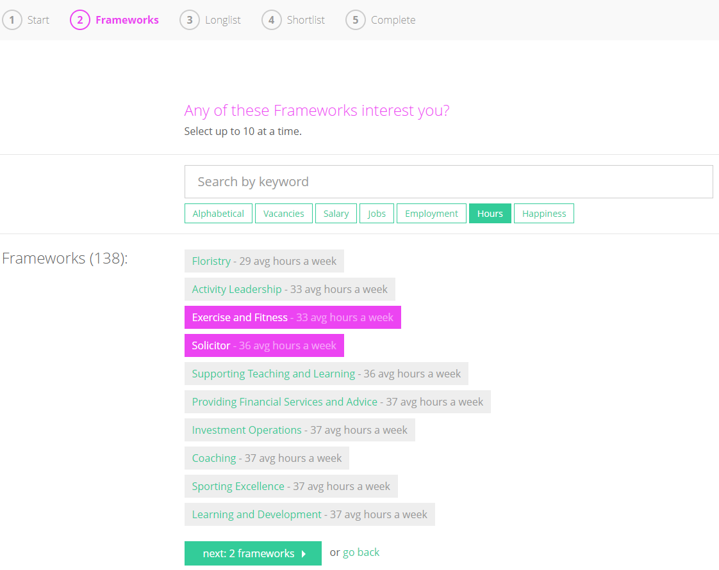
Find Apprenticeships that interest you
Updated every 24 hours, use Unifrog to find apprenticeships which interest you. There are three levels of apprenticeships available; choose the level that works for you with the qualifications you already have and what you want your next step to be.

Slide 11
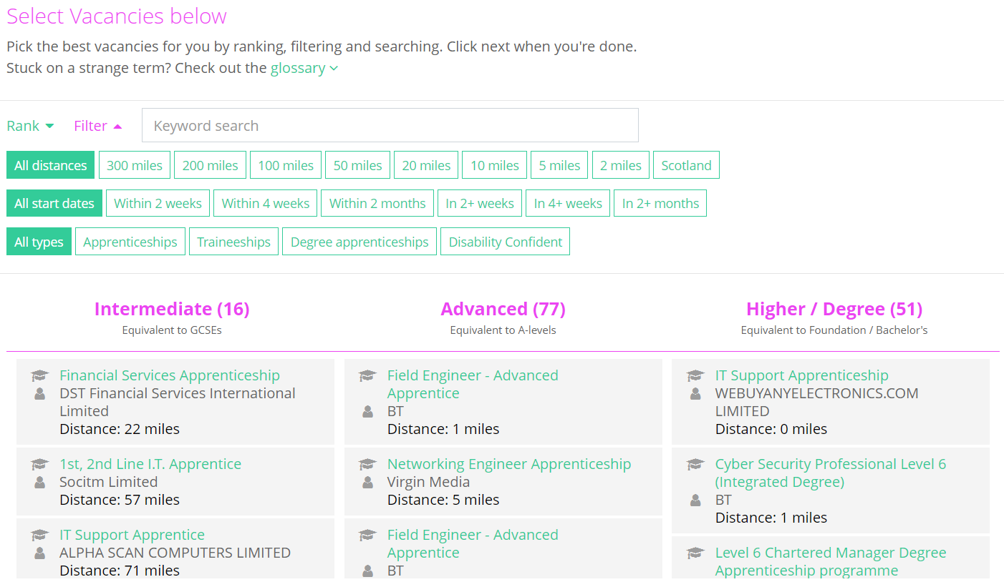
Rank and filter Apprenticeships
Rank and filter apprenticeships to narrow down your searches to what is most important to you.

Slide 12
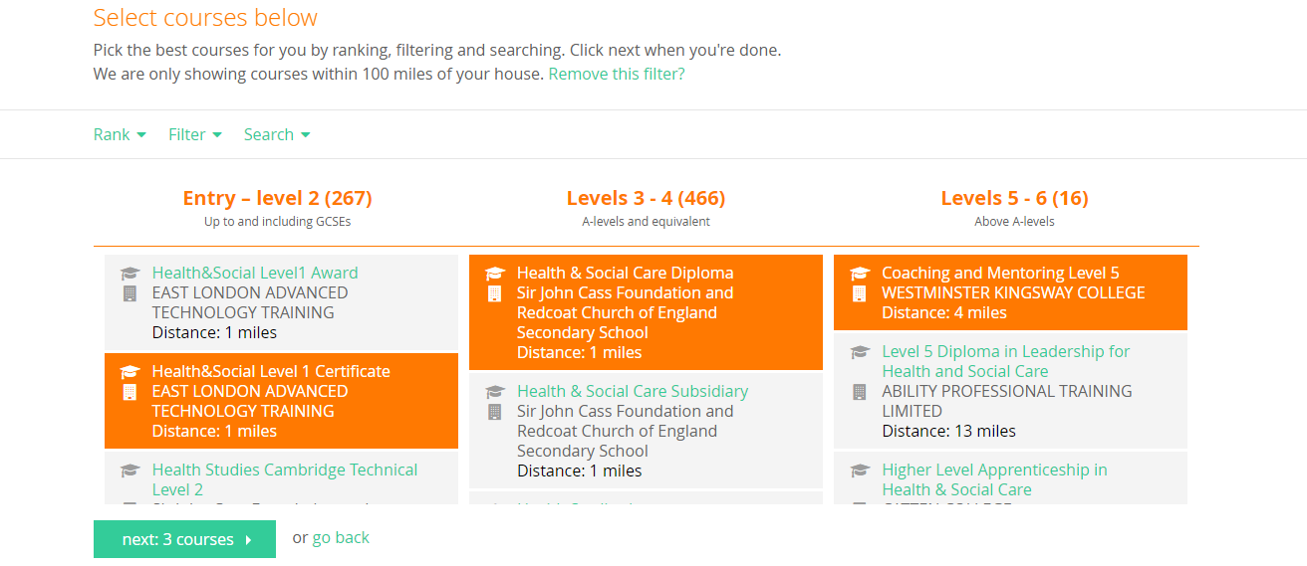
Compare colleges and sixth form courses
Unifrog helps you to compare colleges and sixth form courses at different levels so you can find what’s suitable for you.

Slide 13
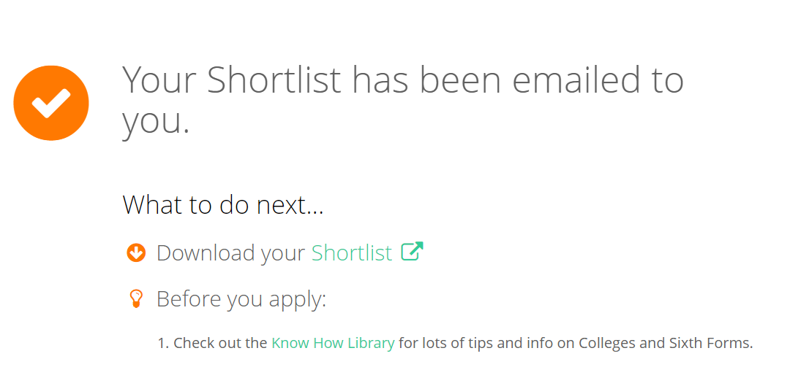
Shortlist your favourite courses before applying

Slide 14
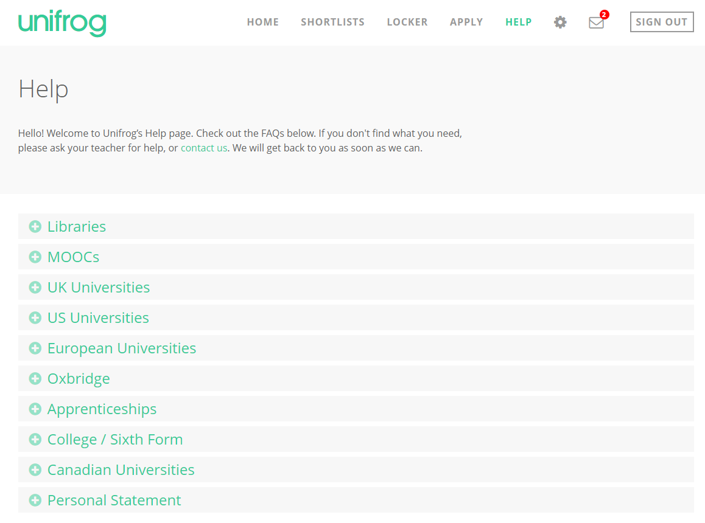
We hope you enjoy using Unifrog!
Use the help section if you need a guide or want some more information about the tools.
If you get stuck, ask your teacher for help!

Slide 15
How can Unifrog help me now?
Explore which subjects you would be interested in studying post-16 and how these choices can lead to different career paths and further education.
Discover and sign up to online courses in areas that you’re interested in and see what is needed to make a successful application to a College/Sixth form.
Explore how to successfully apply to an apprenticeship or university course, including universities abroad.
Support in writing a CV and Cover letter.
Record key activities and achievements to use in your application.

Slide 16
Creating your account
A link has been sent to your school email address (please check your junk/spam mailboxes).
Click the link and follow the instructions.
Create a memorable password.
Make a note of your password.
Notes:
Delete this slide if you are using the form code method

Slide 17
First time registration with Unifrog
When you sign in for the first time, you will use a Form code which will link you with your form tutor.
Notes:
Delete this slide if you are using the student bulk upload method

Slide 18
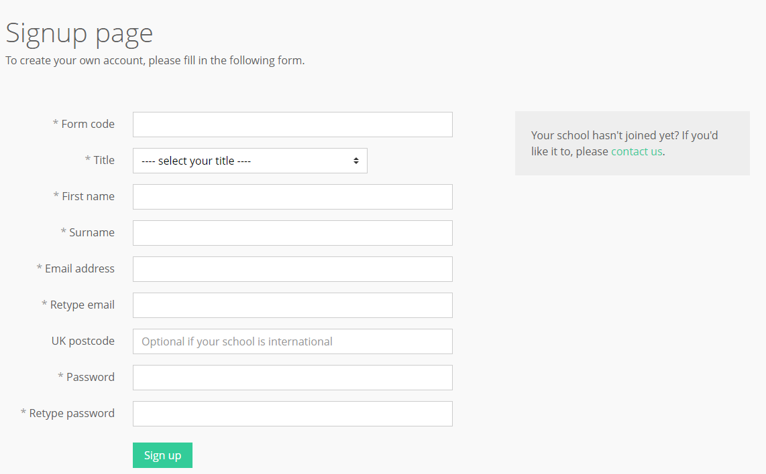
Complete the signup page
Enter your Form code and use your school email address that you access frequently.
Notes:
Delete this slide if you are using the student bulk upload method

Slide 19
Complete the signup page
If you see this message, your form code may have expired or you may have typed it incorrectly.
Ask your teacher for more information.
Notes:
Delete this slide if you are using the student bulk upload method

Slide 20
Every time you login to Unifrog from now on, sign in here
If you forget your password, hit the link to reset (remember to check your junk/spam just in case!)

Slide 21
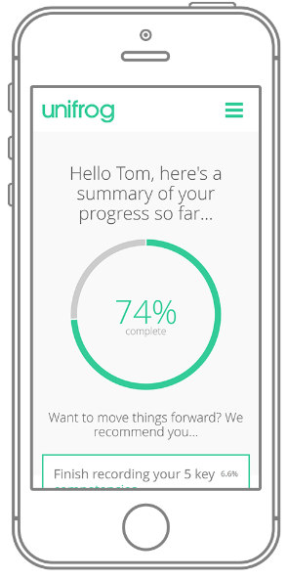
In summary
Unifrog can help you make decisions now about your college and sixth form choices and what you want to study.
Later, it will help you choose the university or apprenticeship that’s right for you.
Be smart. Get ahead of the game!
Sign in now at unifrog.org/sign-in

