Slide 1
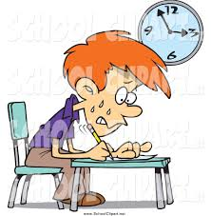
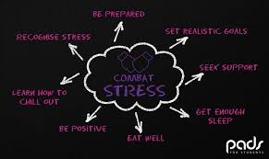
“Don’t Kill Them”- supporting your teen through their exams
Pastoral Support

Slide 2

What to expect…
Exam stress
Coping with your expectations
Coping with our expectations
Coping with their own expectations
Friendships and Relationships will be under strain
Stressed, Frantic, Irritable, Short Tempered, Tearful…nothing new then!

Slide 3
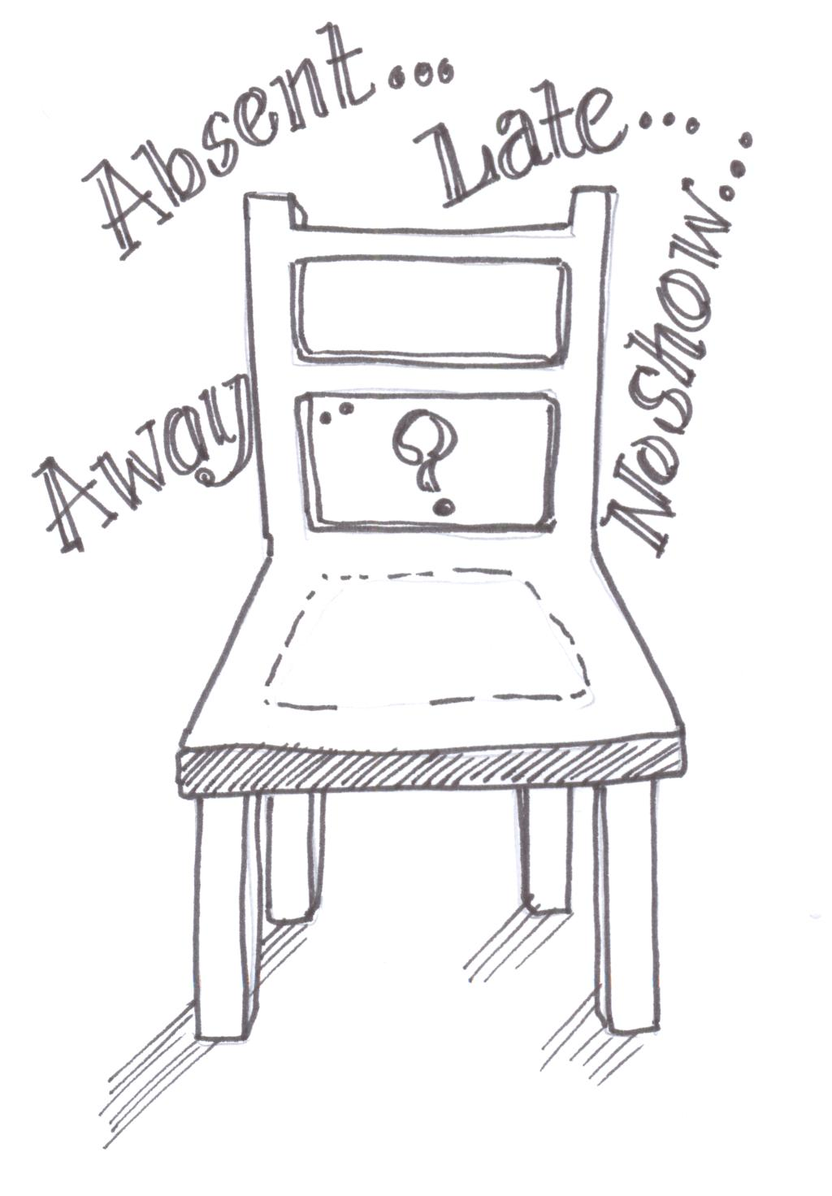
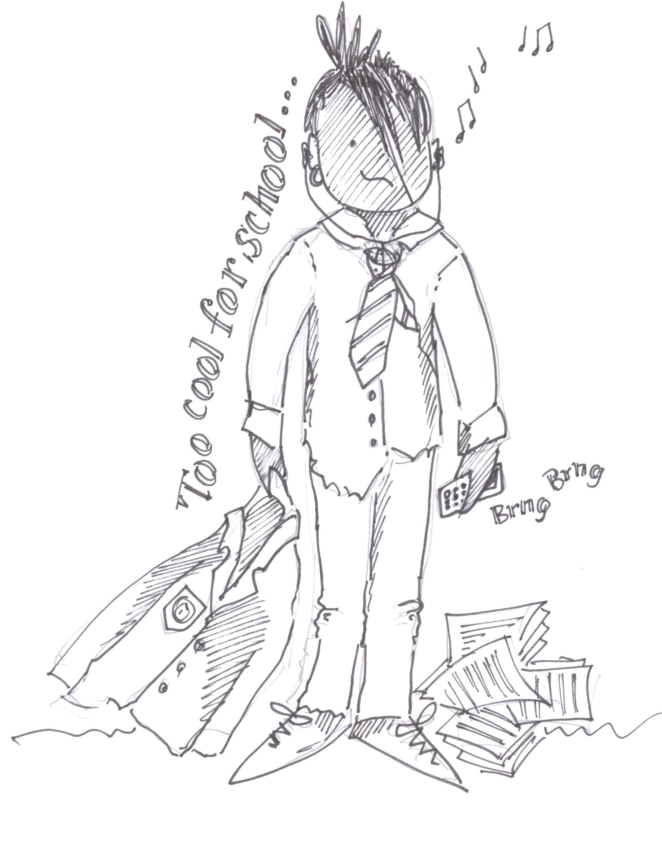
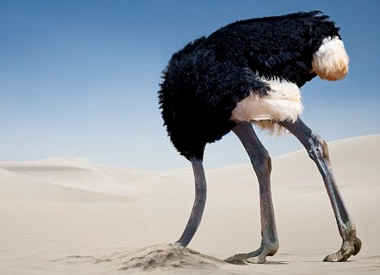
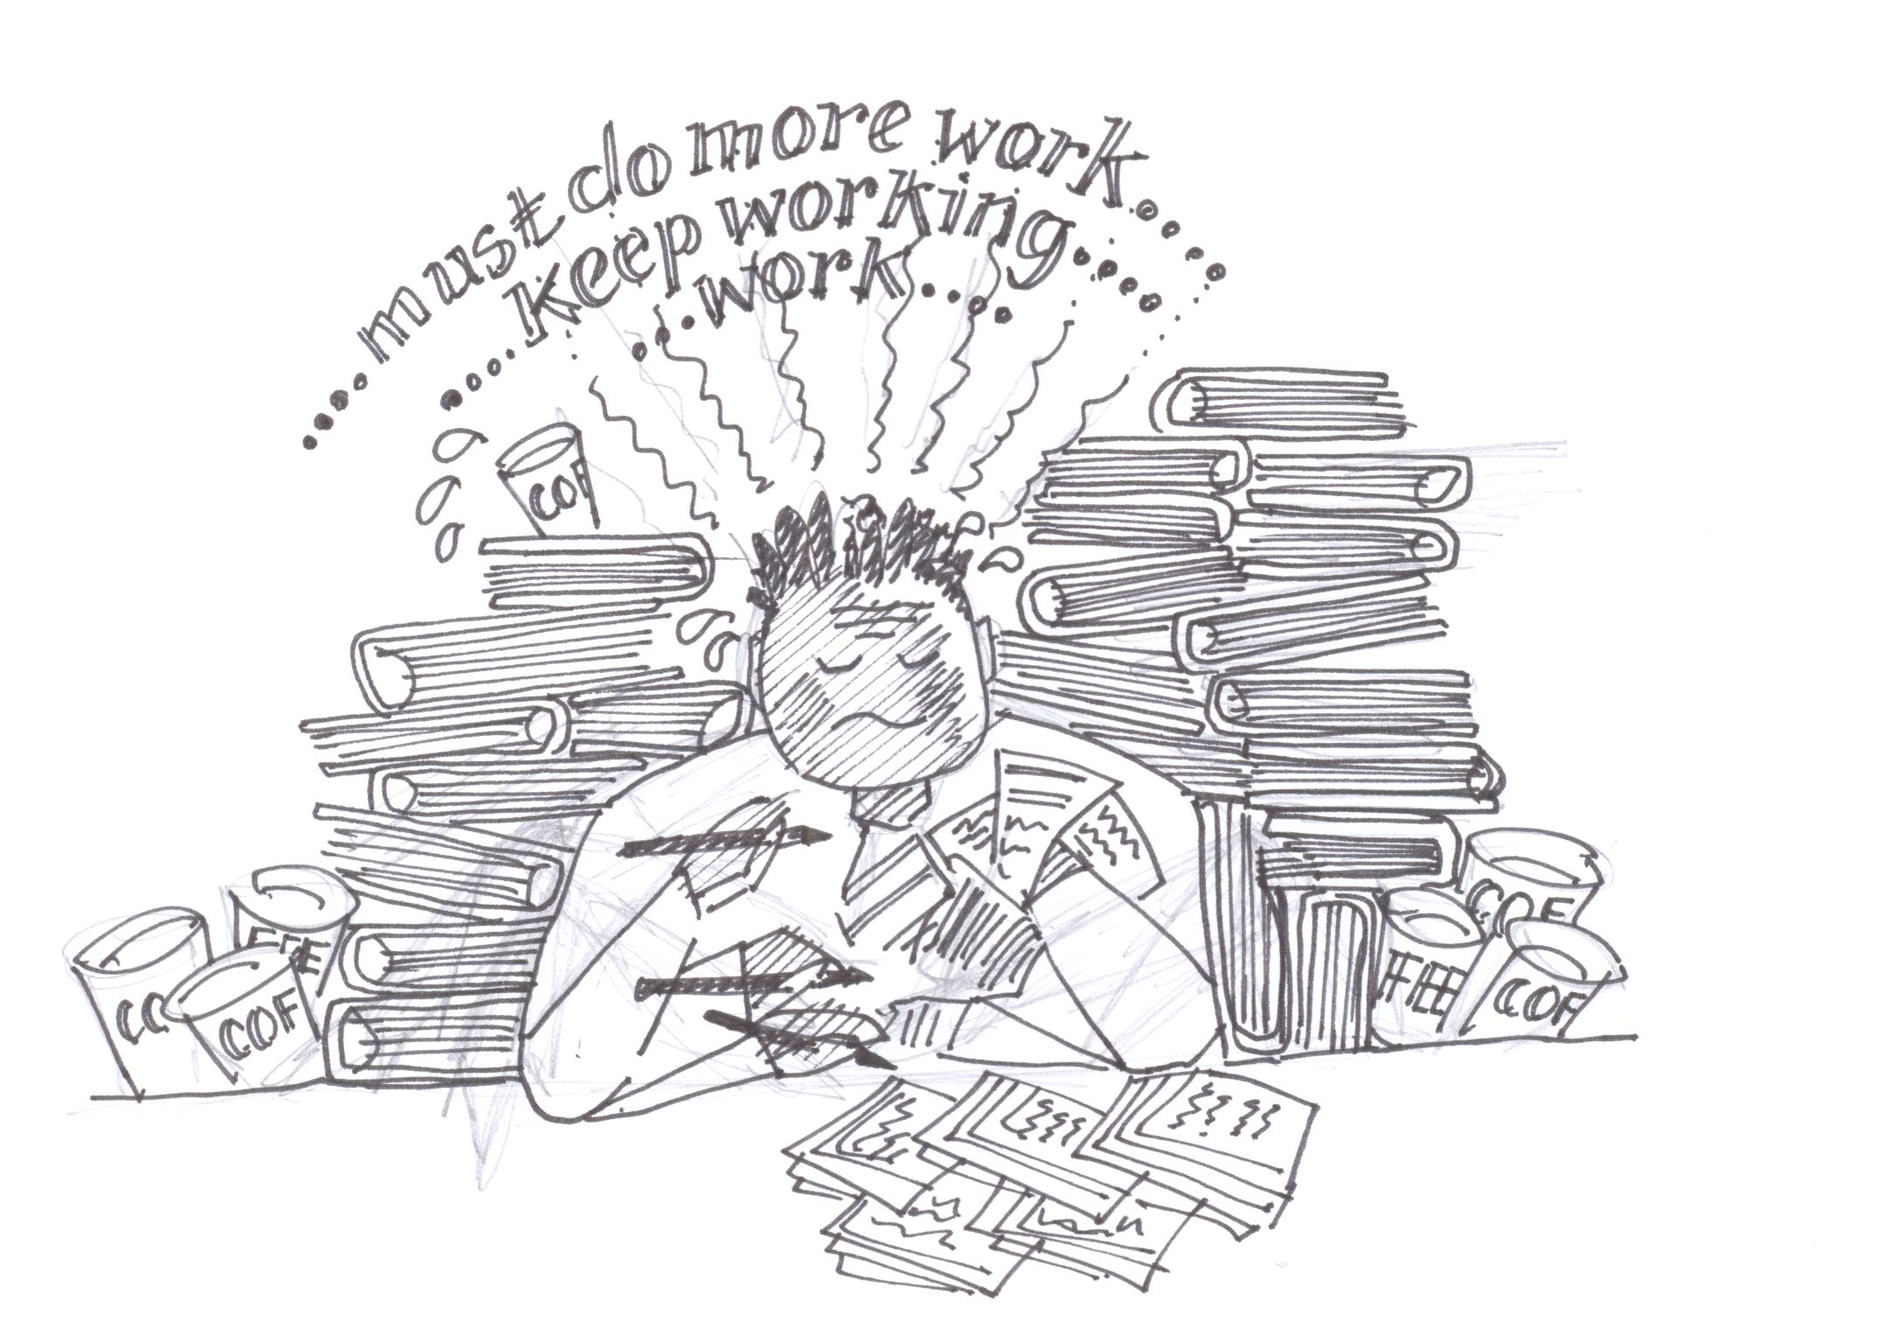
Signs of Stress
Sleeping or eating more/less than normal
Loss of concentration and interest
Tears, tantrums and panic attacks
Lack of confidence
Calls for help such as “hanging around” wanting to talk
Lots of headaches and stomach aches

Slide 4
What are the worst things you can say?
“Remember how well your sister did?”
“Don’t worry, its not a big deal, its only a bit of paper”
At least the exams are much easier now!
“You can only do your best”
“Do you want me to test you on a few things?”
“You need these grades for college”

Slide 5

What do they need…
Patience
Quiet place to revise
Sleep
Eat Well

Slide 6
What can we do…
House | Head of House | Assistant Head of House
Darwin | Ben Coggan | Nikki Penman
Nightingale | Sam Short
Pankhurst | Caroline Uttley | Ali Danelutti
Wilberforce | Janet Williams
firstname.surname@yateley.hants.sch.uk 01252879222
House Centre
Mentoring
Counsellor

