Slide 1
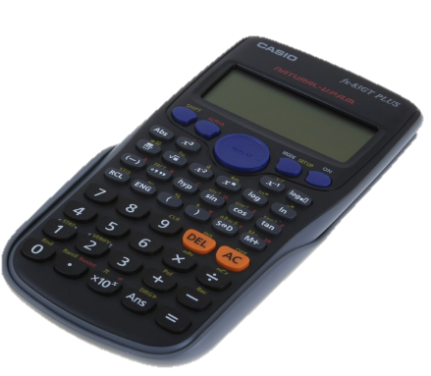
How do I prepare well for my
Maths GCSE?
Mathematics
May 2019

Slide 2
Let me tell you about the man in a boat ….

Slide 3
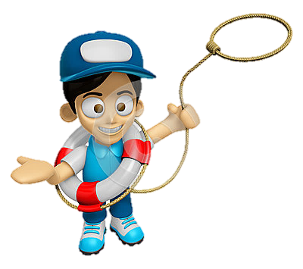
What do you do NOW?
3 steps to Maths GCSE success
1. Understand – Can you do it?
Engage, question and challenge yourself in lessons
2. Recall – Can you do it yourself?
Engage in homework & revision
3. Replicate – Every mark counts! Engage in Skill-up and exam practice
Prepare yourself well and follow our guidance

Slide 4
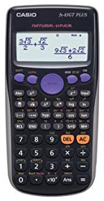
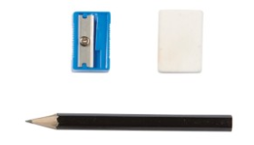
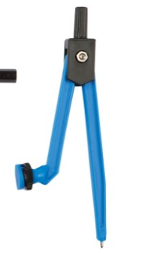
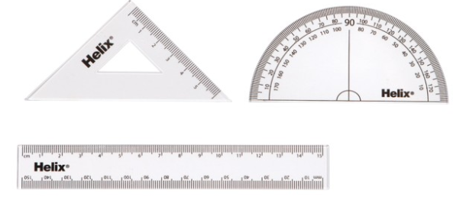
Come to lessons equipped to work
Don’t take the easy road in lessons.
Push yourself …
In lessons
Understand…

Slide 5
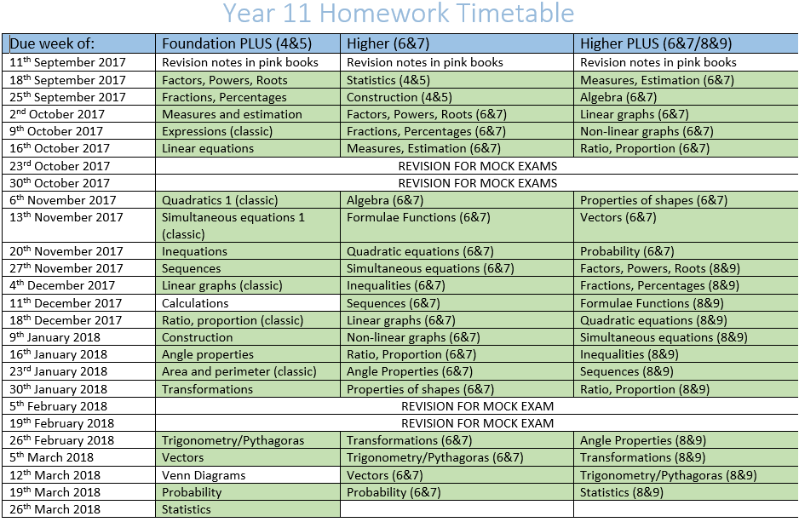
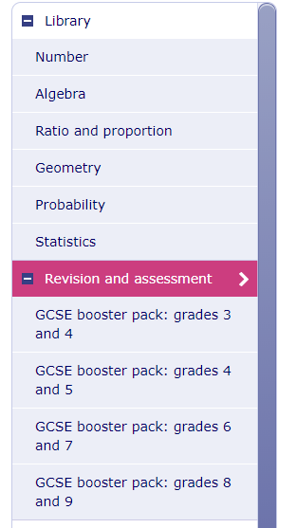
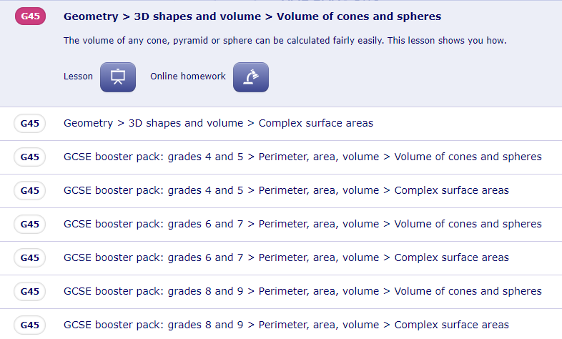
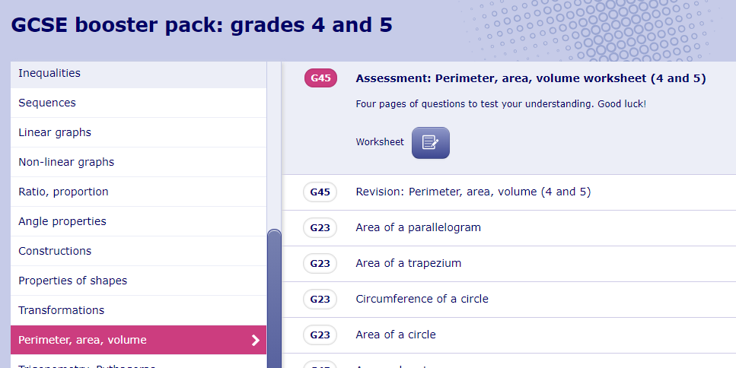
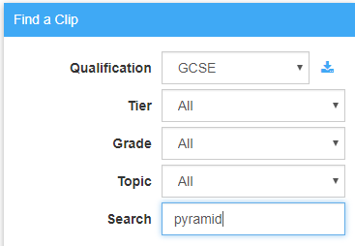
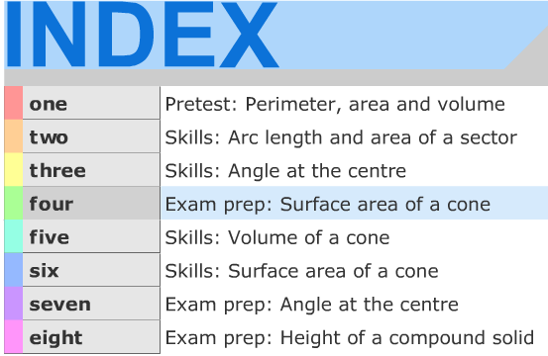
2
3
You are here
1
Revision for every homework
Homework
Understand/Recall…

Slide 6
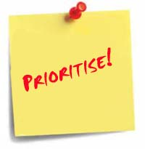
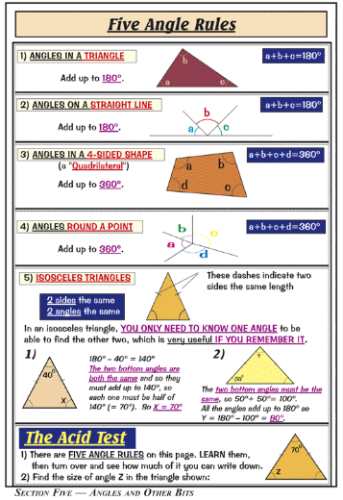
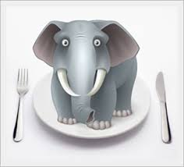
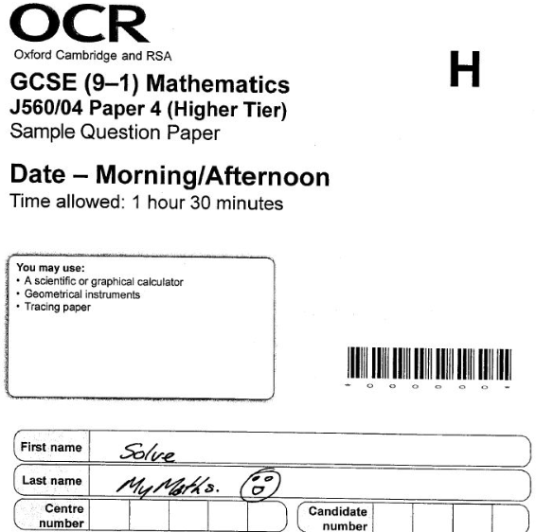
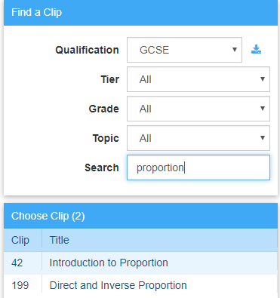
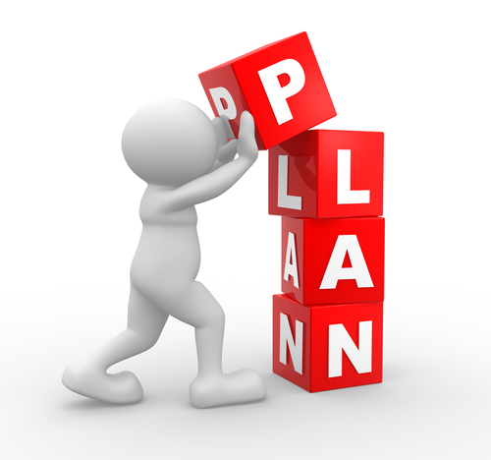
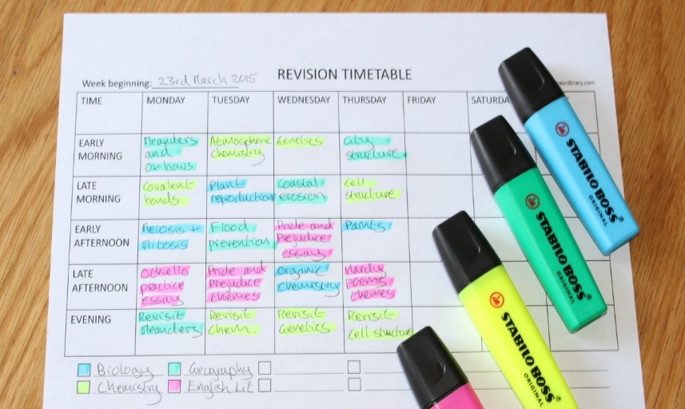
Using your PLC
Do!
Do 20 minutes every evening?
Have weekends free
Use your revision guides and Skill-Up papers
do Maths Revision?
How do you eat an Elephant?
Revision
Understand/Recall…

Slide 7
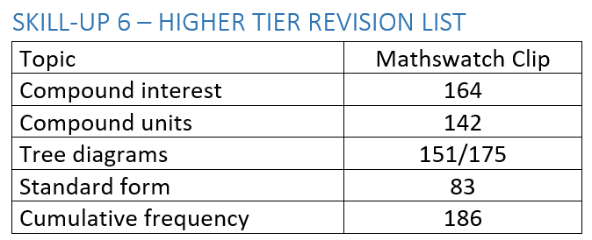
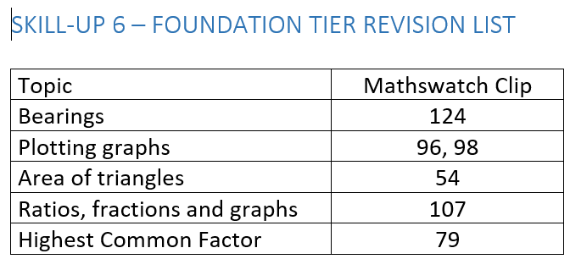
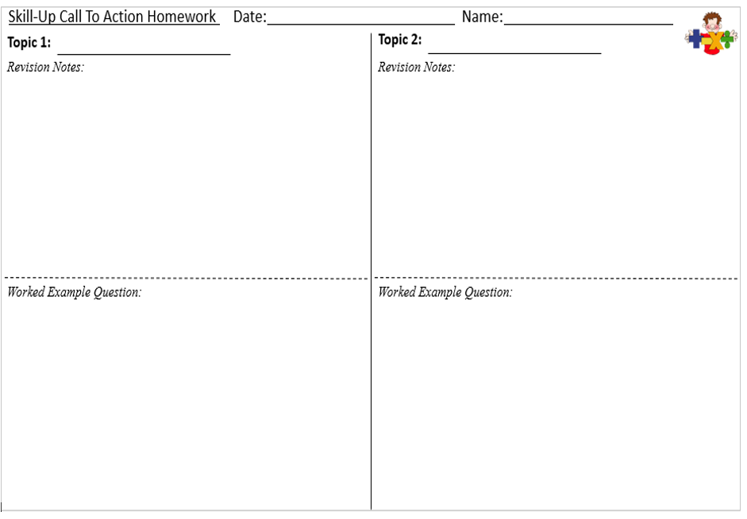
DURING
Identify 3
topics every time and revise them (10 marks x 4?)
Skill-up
Recall / Replicate…

Slide 8
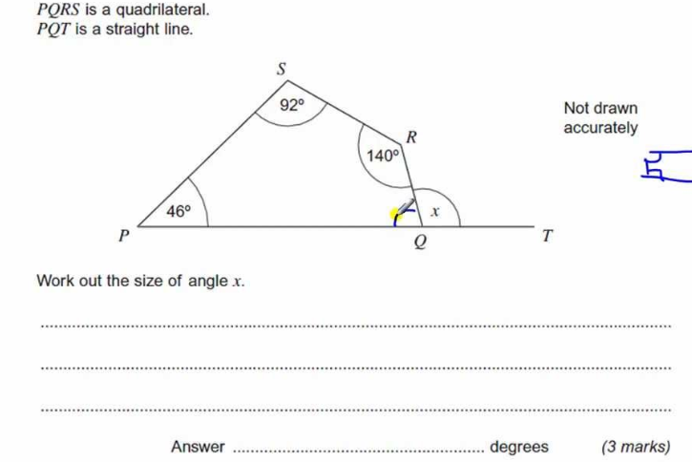
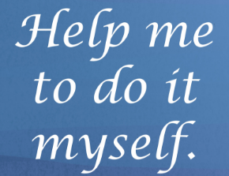
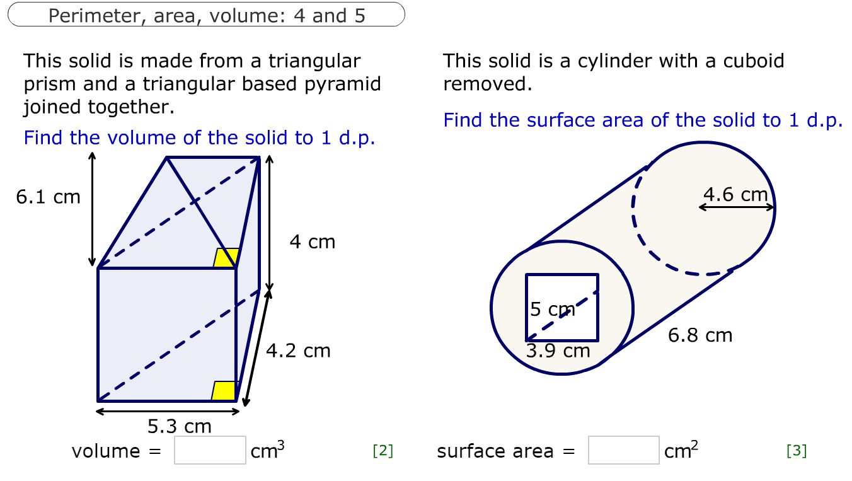
Current homework,
you are now on your own!
Exam practice /
Topic Revision
Bring your revision guides/Skill-Up papers
Revision
(Last week’s homework)
C2.1
C2.5 H / C2.3 F
NEW FORMAT - Every Wednesday
Period 7
Understand/Recall/Replicate…

Slide 9
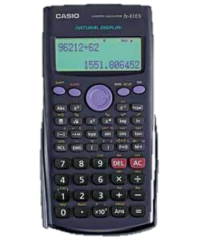
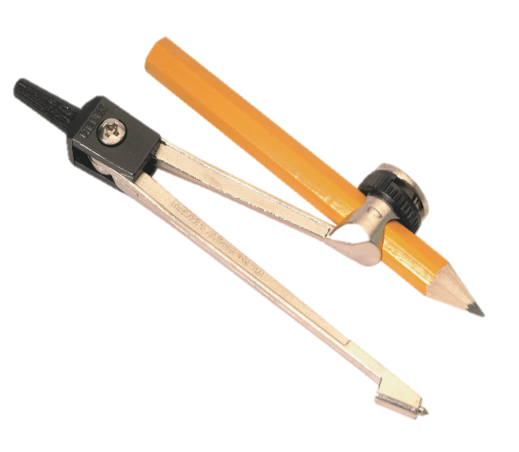
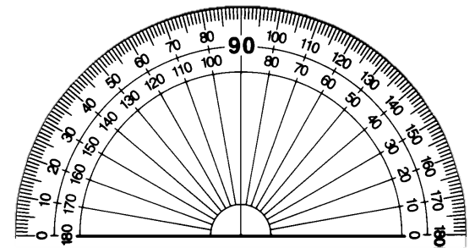
Gain an extra 30 marks…
Become best friends with your Maths Equipment

Slide 10
MOCK 2
MARCH 2019
Paper 1 - Monday 11th March - Periods 5/6 CALCULATOR)
Paper 2 - Friday 15th March - Periods 1/2 (NON CALCULATOR)
Paper 3 - Wednesday 20th March - Periods 1/2 (CALCULATOR)

Slide 11
What do you do NOW?
3 steps to Maths GCSE success
1. Understand
Engage, question and challenge yourself - every lessons from NOW
2. Recall
Homework/Revision/Period 7 - 50 minutes every week from NOW
3. Replicate Skill-Up/Practice Papers/Period 7 - 30 minutes every week from NOW
Plan well… little and often
20 minutes each day, have the weekend off ☺

Slide 12
… do it NOW!

Slide 13
