Slide 1
Succeeding in Science
7th Mar 2019
Warren Stacey
Head of Science

Slide 2
Agenda
Science course structure
Additional support in school
Revision planning
Revision techniques
Areas students miss
Resources
Parent to do list

Slide 3
Science Course Structure…
Combined Science (Double) | Separate Science (Triple)
Two GCSEs | Biology GCSE, Chemistry GCSE & Physics GCSE
6x1hr 15min papers (2 Biology, 2 Chemistry & 2 Physics) | 6x1hr 45min papers (2 Biology, 2 Chemistry & 2 Physics)
Each paper covers specific topics | Each paper covers specific topics
Grade based on total mark from 6 papers | Grade based on marks in each subject
Highest grade taking the Foundation paper is a 55. Lowest grade taking the Higher paper is a 43 (below that is UU) | Highest grade taking the Foundation paper is a 55. Lowest grade taking the Higher paper is a 4 (below that is UU)

Slide 4
Support in school…
Period 7s:
Every Wednesday – 1 session for all students & 1 session for Trebles
Pre-work is set that must be completed
Voluntary attendance
Not ‘re-teaching’ content
Lunchtime clinics:
Monday is Chemistry, Tuesday is Physics & Wed is Biology
Students bring a question they can’t do
Teacher supports student working through the question (not necessarily giving them the answer)

Slide 5
Revision planning…
Plan:
Scheduled revision sessions
Topics identified for each session
Limit each session to a max 40min (then a break, then next session)
Topics need to be revisited
How much Science revision:
Minimum 30mins per day – double that at the weekend
Significantly more for Trebles as they have less class time
This should increase as exams approach, or if mock results do not meet target
Don’t prioritise coursework over revision – that’s storing trouble up for later

Slide 6
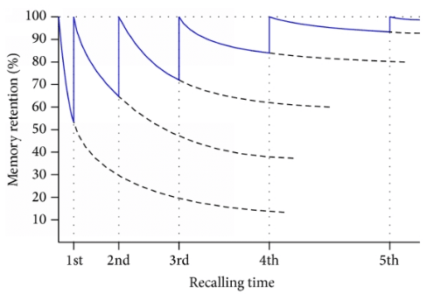
Ebbinghaus Forgetting Curve
You have to revisit & re-use information to retain it.
As such revision must include regularly revisiting content.

Slide 7
Revision techniques…
Science needs you to:
know a lot of content
be able to apply the content
Too many students spend time writing ‘beautiful’ notes. These notes are often wrong or do not cover the key points. The notes take so long to write they don’t have time to learn the content. Students don’t then spend any time practicing the application.
More effective techniques:
Flash cards
Practice questions
If a students can’t answer a question on it then they don’t know it.

Slide 8
Areas students miss…
Equations:
It is imperative that students know the Physics equations
Can they recite them to you ?
Required Practicals:
There are (about) 5 required practicals for each paper
Students need to know how to perform the practicals – including writing a method
Can they explain them to you ?

Slide 9
Resources…
Google drive (www.google.com the log on to their @yateleyschool.net account):
KnowIt – Powerpoints covering the content then asking questions (with answers)
Learning Grid – Has questions for each part of the specification (with answers). Once complete form a revision resource.
GraspIt – Exam style questions (with answers)
Videos:
Free Online Science Lessons (https://www.youtube.com/channel/UCqbOeHaAUXw9Il7sBVG3_bw)
CGP Revision Guides & Workbooks.
MyOnlineScienceTutor:
Multiple choice questions around videos (https://myonlinesciencetutor.com/). Tracks student progress showing where they need to focus.
Students must not revise by ‘googling’. Content is often for the old specification, a differeny exam board – or just plain wrong !!!

Slide 10
Parents to do list…
Is the revision plan in place & suitable ?
Are revision resources & environment available ?
Are the revision activities suitable ?
Is the revision plan being followed ?
Are they revising the right topics for the right papers ?
Do they know the Physics equations ?
Do they know the required practicals ?
Can they demonstrate their knowledge (Flashcards, KnowIt, Learning Grid)
Can they demonstrate they can answer questions (GraspIt)
Can you join in ?

