Slide 1
Parent
Seminar

Slide 2
Elevate Education – Who are we?
Research: Why do the top students get the top results?
Work with the top students around the world (3000+ schools, across 5 countries)
13 key study habits

Slide 3
13 key skills
Belief
Stress
Goals
Post Exam
Environment
Memory skills
Team
Success
Exam preparation
Results oriented
Practice questions/mock exams
Organization skills
Independent work
Use of holidays

Slide 4
Elevate Parent Seminar
Time Management

Slide 5
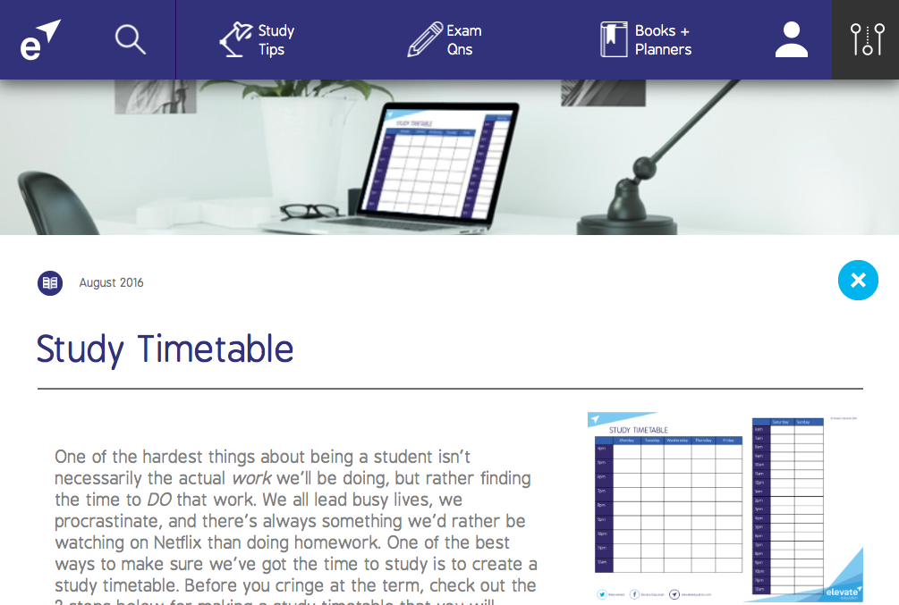
Elevate Education – Study Timetables
What?
When?
Sport
What?
When?
Social
What?
When?
Hobbies
What?
When?
TV
What?
When?
Job

Slide 6
Elevate Education – Study Timetables
 | MONDAY | TUESDAY | WEDNESDAY | THURSDAY | FRIDAY | SATURDAY | SUNDAY
7:00 |  |  |  |  |  |  | Sleep in
8:00 | School
9:00
10:00 |  |  |  |  |  | Basketball
11:00
12:00
1:00
2:00
3:00
4:00 |  | Swimming |  | Swimming
5:00 |  |  | Guitar lesson |  | McDonalds
6:00 |  |  |  |  |  | Party
7:00
8:00 | Netflix
9:00 |  |  | Netflix
10:00
11:00
12:00
Fun stuff first
Regular study sessions in the gaps

Slide 7
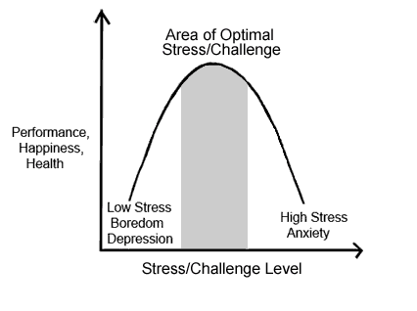
Elevate Education – Study Timetables
Checklists
Tasks, not time
50 - 60%

Slide 8
Elevate Parent Seminar
Motivation

Slide 9
Hierarchy of Motivation
Details of Course
University in general
Workforce
Complete Clarity
Goal
Clarity
Fully
Motivated
No Why
Largely Motivated
Uncertainty/ Multiple options
Flat liners
www.ucas.com
No link
Unmotivated
www.notgoingtouni.co.uk

Slide 10
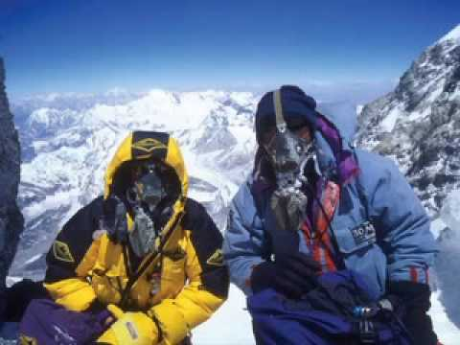
Setting a goal
Step 1: Consider options and write down what you want to do
Step 2: Determine entrance requirements
Step 3: Account for rising entrance scores
Step 4: Write the goal down & make it visual

Slide 11
Overwhelmed and Stress
Other options:
Alternative University
Transfer
Study Post-graduate
Private Colleges

Slide 12
Elevate Parent Seminar
What to do

Slide 13
3 types of work
Practice Papers
Making notes during term
Extra reading [literary analyses, in depth facts, alternative arguments, quotes]

Slide 14
Elevate Parent Seminar
Dealing with Technology

Slide 15
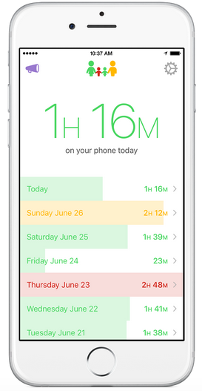
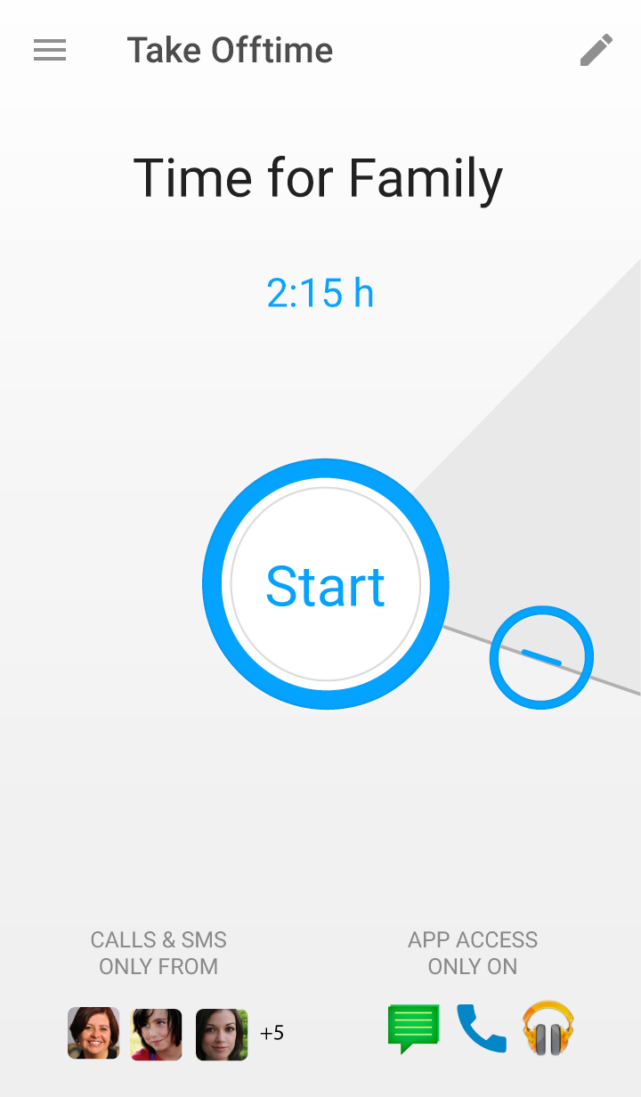
Dealing with tech
Controlling behaviour → self-regulating behaviour
High powered vs low powered work

Slide 16
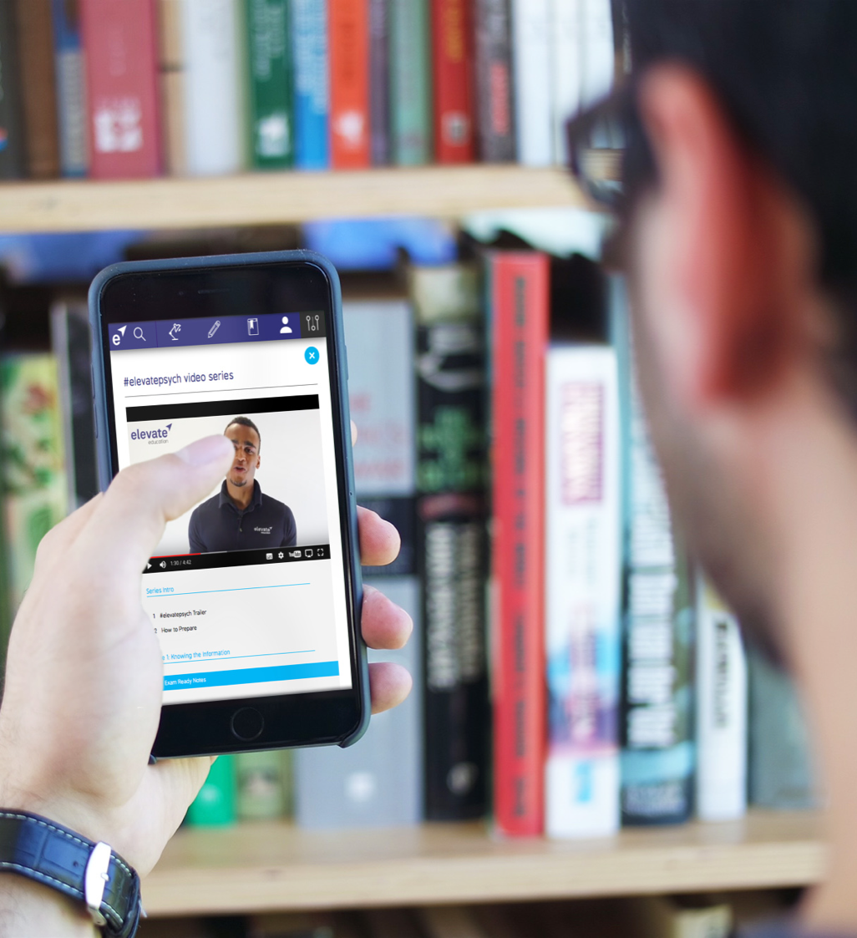
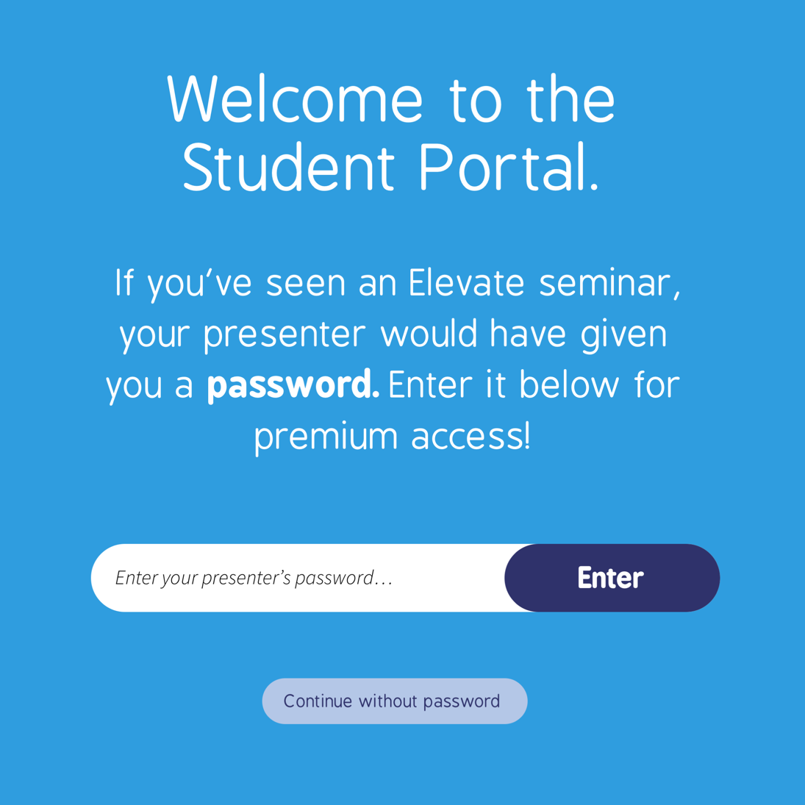
rondo

Slide 17
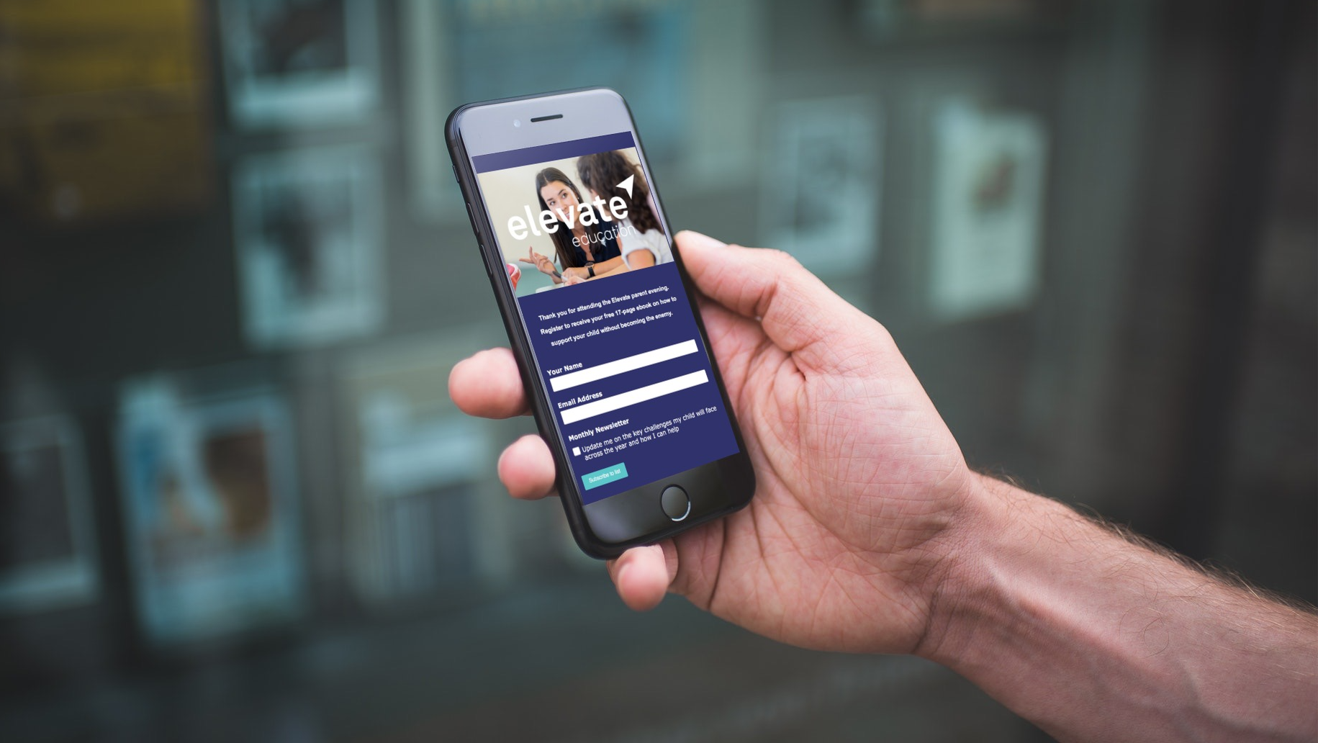
Visit:
eepurl.com/djMpeD

