Slide 1
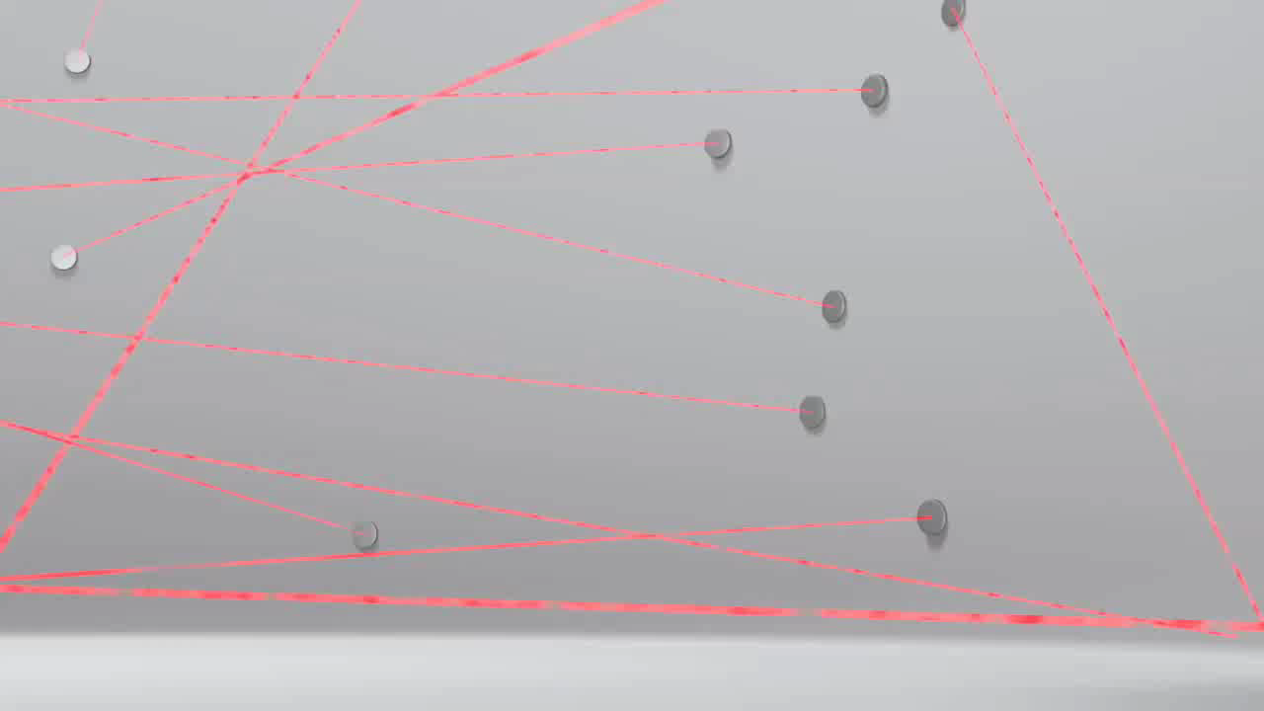


Revision Planning and Organisation – How hard can it be?

Slide 2

So how to get started…
Make a list of the GCSE / Exam Subject’s.
Obtain a list of the relevant ‘topics’ for each subject.
ALERT! Students need to check with their subject tutor that they have the relevant topic list for their subject and examination level.
Students can obtain their topic list from the text book’s that they use in class, GCSE internet revision sites and ultimately from their class teacher.

Slide 3


Then Traffic Light!
Highlight the topic lists ……
Not confident with a topic highlight it!
RED
A little more confident or just ok highlight it!
ORANGE
100% confident with a topic highlight it!
GREEN
If you are not sure test yourself.
Having revised a topic – change the colour!

Slide 4



Preferred Learning Styles?
Which preferred learning style is your son/daughter?
            Lookers
  Learn and revise best through pictures, mind maps, watching videos, live performances, computer web sites and DS.
            Listeners
  Like to hear a person explaining things , to summarise aloud and record study / revision perhaps to an eye pod. They like to repeat things aloud and make up rhymes and mnemonics.
            Doers
  Prefer to take part in experiments, manipulation of objects. Basically hands-on learning. Mind mapping , computer web sites , flash cards, using post it notes and walk around when they are reading.

Slide 5
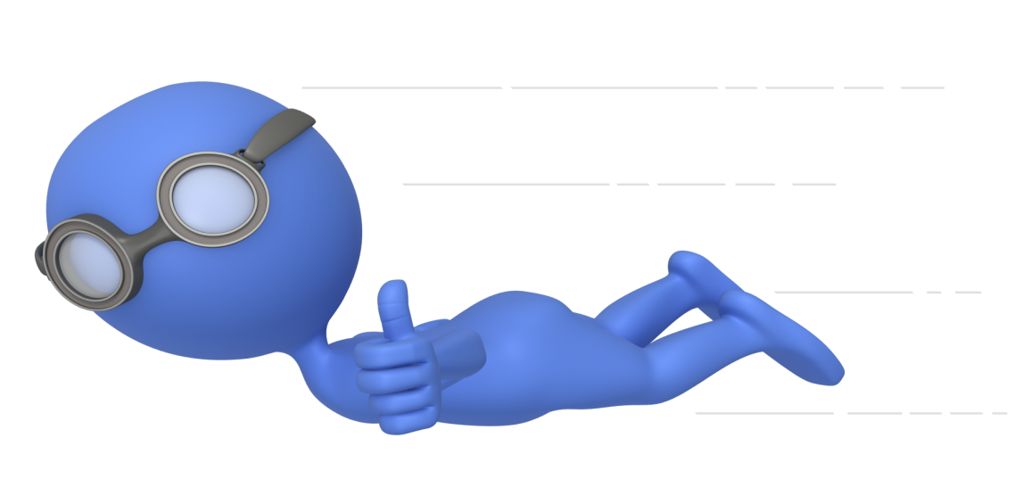
Now to a revision plan……
Spend time in planning revision ….
1
A revision plan should be realistic and flexible…
Use a calendar displaying weeks, or months, or days leading up to their exams.
2
3
Transfer the topics onto the revision plan / calendar
Use colour prioritising your red, orange and green topics.
Choose the revision tool that best suits the topic e.g. a post – it wall , mind map, past papers , GCSE Pod , recommend web sites, buddy study, revision guides, after school sessions…
4
Change the topic colour as they go along and feel more confident. Tick the topics off of the list as they are successfully completed.

Slide 6
Revision Sites
BBC Bitesize
Revise it, Videos, Tests…
GCSE POD
Exercises, Games, Tests…
Get Revising
Revision Plans, Revision Notes, Papers…
Other subject sites
Seneca (Geography), My Maths, Maths Workout, Kerboodle (Science)…
Do make sure that you identify the correct exam board!

Slide 7
How can you make a difference…..
The good news is that you do not have to be an expert in any of you son or daughters subjects to make a real difference and you don’t have to become a super parent by giving up your own life and responsibilities….
Just be there for them!

Slide 8
How you can help to IGNITE their BRAIN!
Make sure they have a healthy balanced diet. You are what you eat!
Drink plenty of water. 65% of our body is made up of water and the brain by 75%. As little as 2% dehydration, that’s less than it takes to feel thirsty – can cause a concentration drop by up to 20%.
Take regular exercise, make time to socialise, take periodic breaks. At least 10 minutes every hour.
This will help them to keep focused and disciplined…

Slide 9



Remember to ENCOURAGE &
REWARD when they have done well!

Slide 10
Ready to Launch?!?
BUT …..Remember – you are the person that will LOVE THEM and be PROUD OF THEM no matter what ….
A thought - ‘if they do what they always did, they will get what they always got…’

Slide 11

Questions? Comments?
We are happy to help you.
Thank you for coming along this evening!
We hope that it has been useful…
Mrs Bailey.

