Slide 1
Revision Tricks and Tips

Slide 2
Two illustrations:

Slide 3
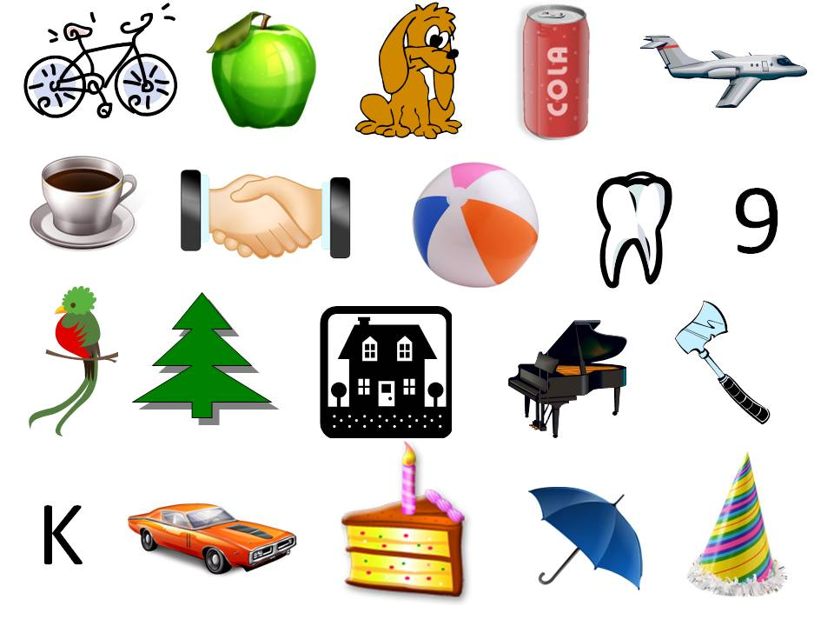

Slide 4
HERE IS YOUR FOUR DIGIT NUMBER…
8391
Say this four digit number (in your head) as four individual digits
Eight Three Nine One
The Challenge:
On each click of a metronome you need to “+1” to each of the four numbers, so…
Eight Three Nine One
NINE
FOUR
?
?

Slide 5
YOUR TURN…
8391
The Challenge:
A metronome will soon sound at 55bpm.
We’ll have a three second countdown before we start
On each beat you +1 (to each individual digit)
When the metronome stops, write down your new number.

Slide 6
YOUR TURN…
2735

Slide 7
Some amazing stats
At a first attempt only 12% of the population sample were able to complete this task at 55 bpm.
By the fifth attempt the success rate rises to 46%
By the tenth attempt, the success rate had reached 74%
Fun fact, only 0.4% of the population can do the same task first time but adding 3 to each digit.

Slide 8
Some more amazing stats
During this exercise your heart rate will have likely increased by between 5-10 bpm, principally to send blood to the brain.
A non-invasive scan called fMRI (functional magnetic resonance imaging) shows an increased neural activity (triggered by blood flow) of up to 20% in adults.
Acquiring a new skill or new knowledge literally causes stress!
(Fun fact, only 0.4% of the population can do the same task but adding 3 each time)

Slide 9
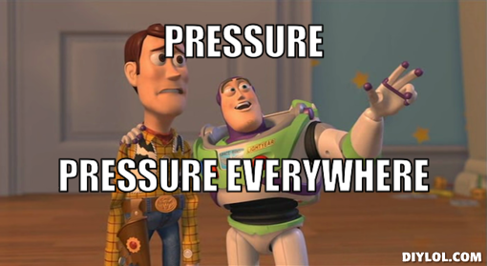

Slide 10
LESSON #1
You are not doing these exams.

Slide 11
LESSON #2
You CAN improve their performance in these exams.

Slide 12
How to support them…
Basics:
Understand their learning style.
They might be different to you in their learning style.
Their brains do not function in the same way as yours.
They do care.
Managing distractions is incredibly important
Rewards motivate, punishments rarely do.
Discuss what THEY want to achieve

Slide 13
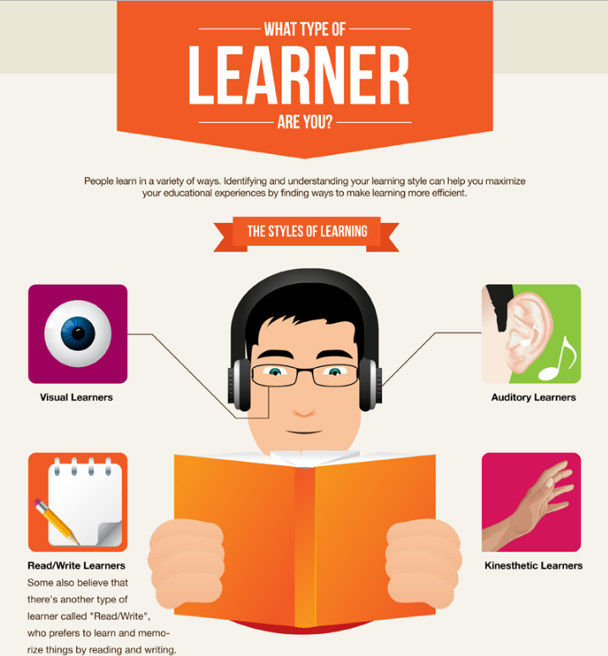

Slide 14
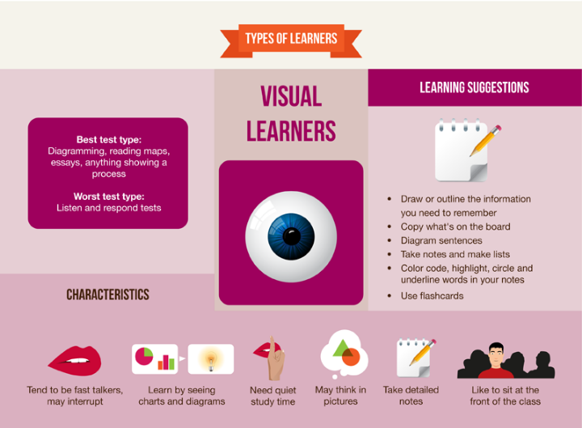

Slide 15
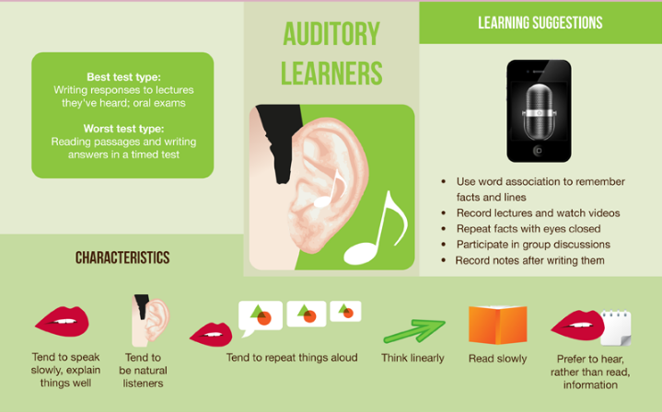

Slide 17
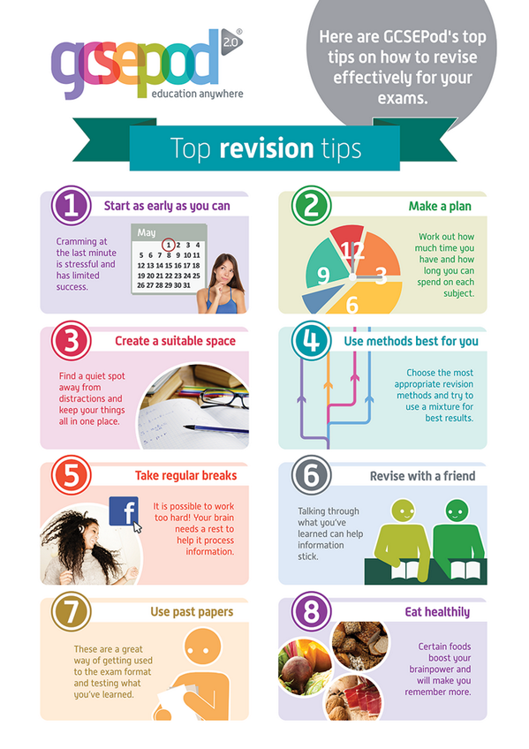

Slide 18
LESSON #3
There is no preparation for exams
that is more effective than attempting past exam papers
and mark schemes.

Slide 19
You may judge them but…
Support Level | Description
 | Shows no engagement with revision/exams at all
 | Asks “how are things are going?” or “have you revised?” but no more.
 | Buys them text books or revision guides and asks them how it’s going
 | Asks specific questions about child’s revision and what they’ve learned
 | Actively questions child about what they’ve learned in their revision, gets to know subject content, helps child to create and use a revision timetable. Listens to their concerns and doesn’t judge.
 | Asks subject-specific questions about revision. Downloads exams and mark schemes from exam board to help child. Supports their child with time management creating/sticking to their timetable. Is patient with and praises child!
What about you?

Slide 20
LESSON #4
Your ONE question
when your don't know what to
ASK

Slide 21
WHY?
The one word you need!

